Slide 1
IPMS
Phase 1.5 Release

Slide 2
Planning BEFORE you buy gives you more control over the outcome. When you have control over the outcome, the chances of success are GREATER!

Slide 3
Making Your Life Easier – December 2020
Straight Rate and Manure
Seed Planned Products
Mgmt Zone Page
What’s Next

Slide 4
Benefits to you
Show new website developments
How to use these new features
Easier Data Entry
Better reporting
More deliverables
You look like a Rockstar.

Slide 5
IPMS TIMELINE
Development Timeline
Phase 2
Phase 3
Phase 4
Phase 5
Commercial Launch
Fall 2020
Spring 2021
Fall 2021
Spring 2022
Fall 2022
Fall 2022
Phase 1
Field Enrollment
Crop setting
Entities mgmt.
Crop planning
Enterprise Reports
Planned vs actual data mgmt.
Plan vs in season
Data editing
Inventory mgmt.
Invoice mgmt.
Language & units
Performance Zone validation
New look rollout
Performance Zones
NexGenRx validation
Spatial application files
FSA, BLM, etc. data
Updating reporting
Weather data
Rotate/auto rotate crops
Equip/Display details
Crop zones & Dbl crop removals
Consolidated ELB workflow
FSA, Crop Ins., Lender, Farm mgmt. reports
Work Orders
Reports details
Website Dashboards
Key Insights Auto Populated
NexGenRx V1.0
Goals/Objectives
Farm employee mgmt.

Slide 6
Straight Rate and Manure

Slide 7
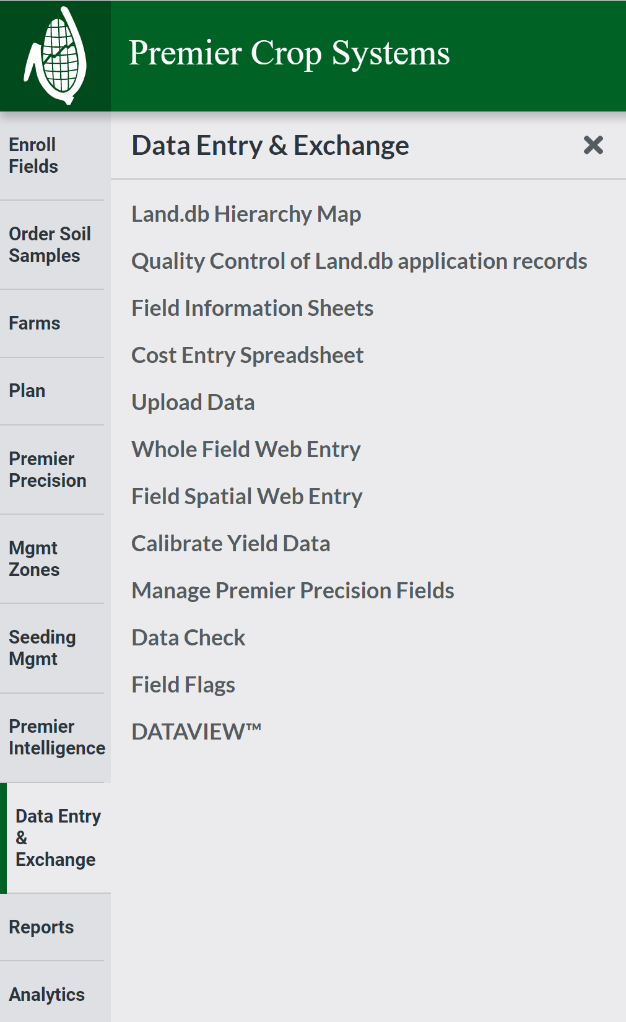
Straight Rate and Manure Planned Applications
Need to account for these in the Nutrient Plan.
These applications need to be accounted for correctly and quickly.
Whole Field Web Entry is going away.

Slide 8
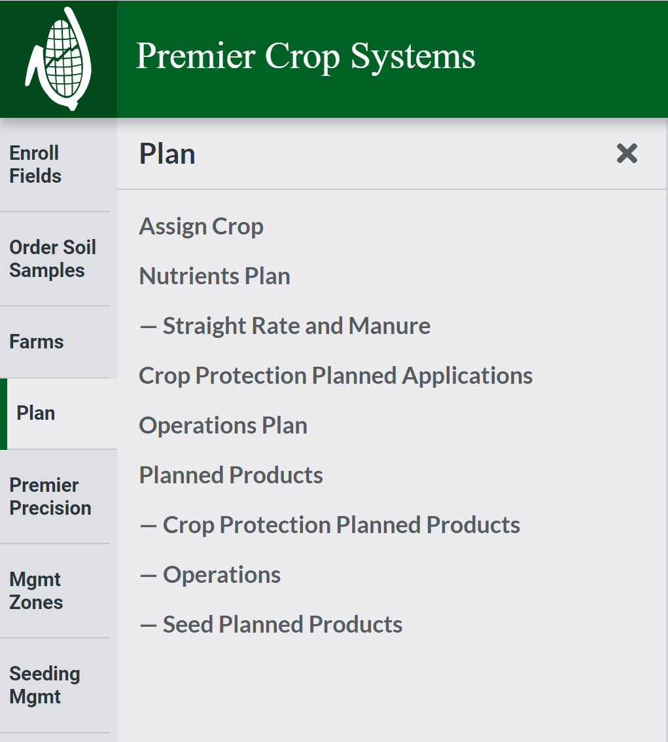
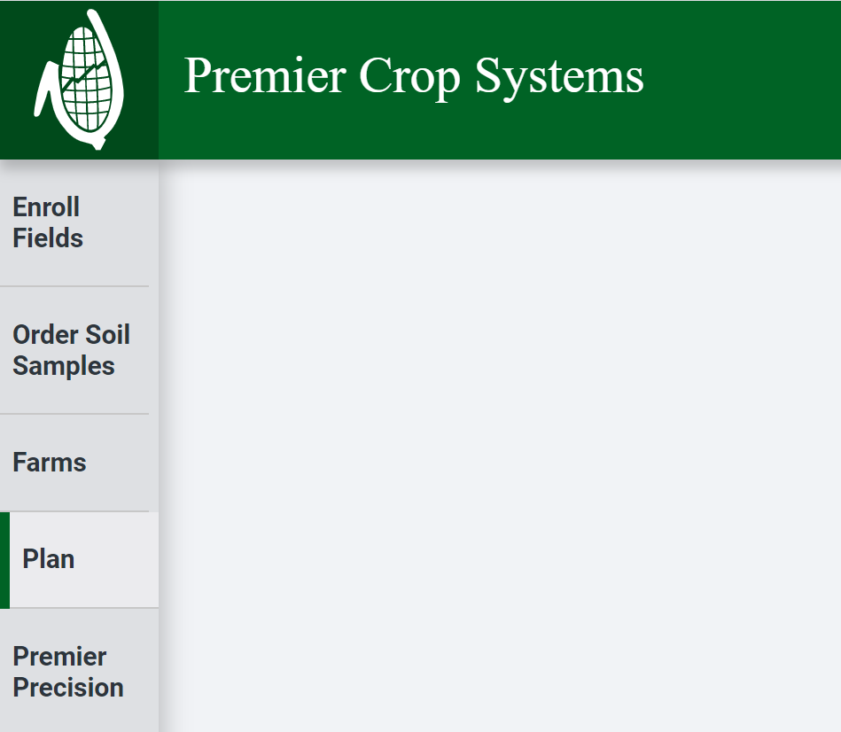

Slide 9
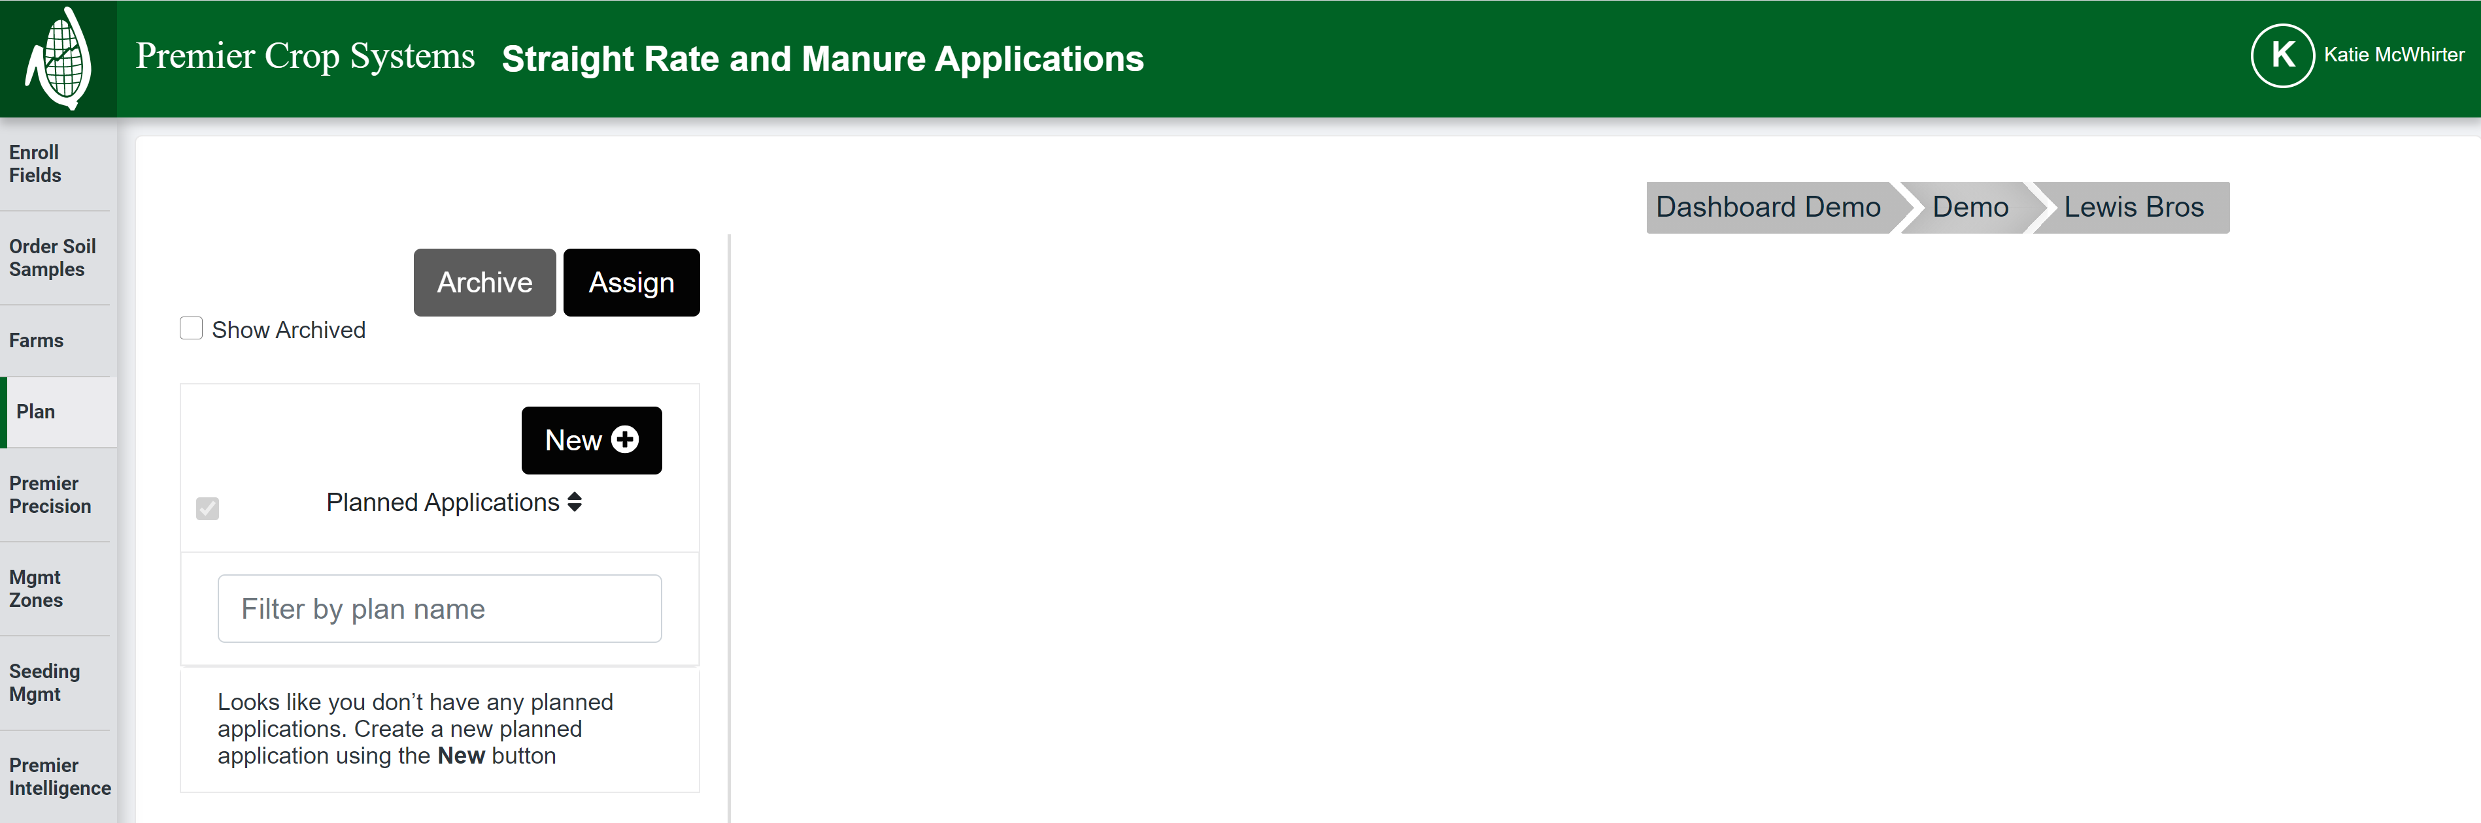
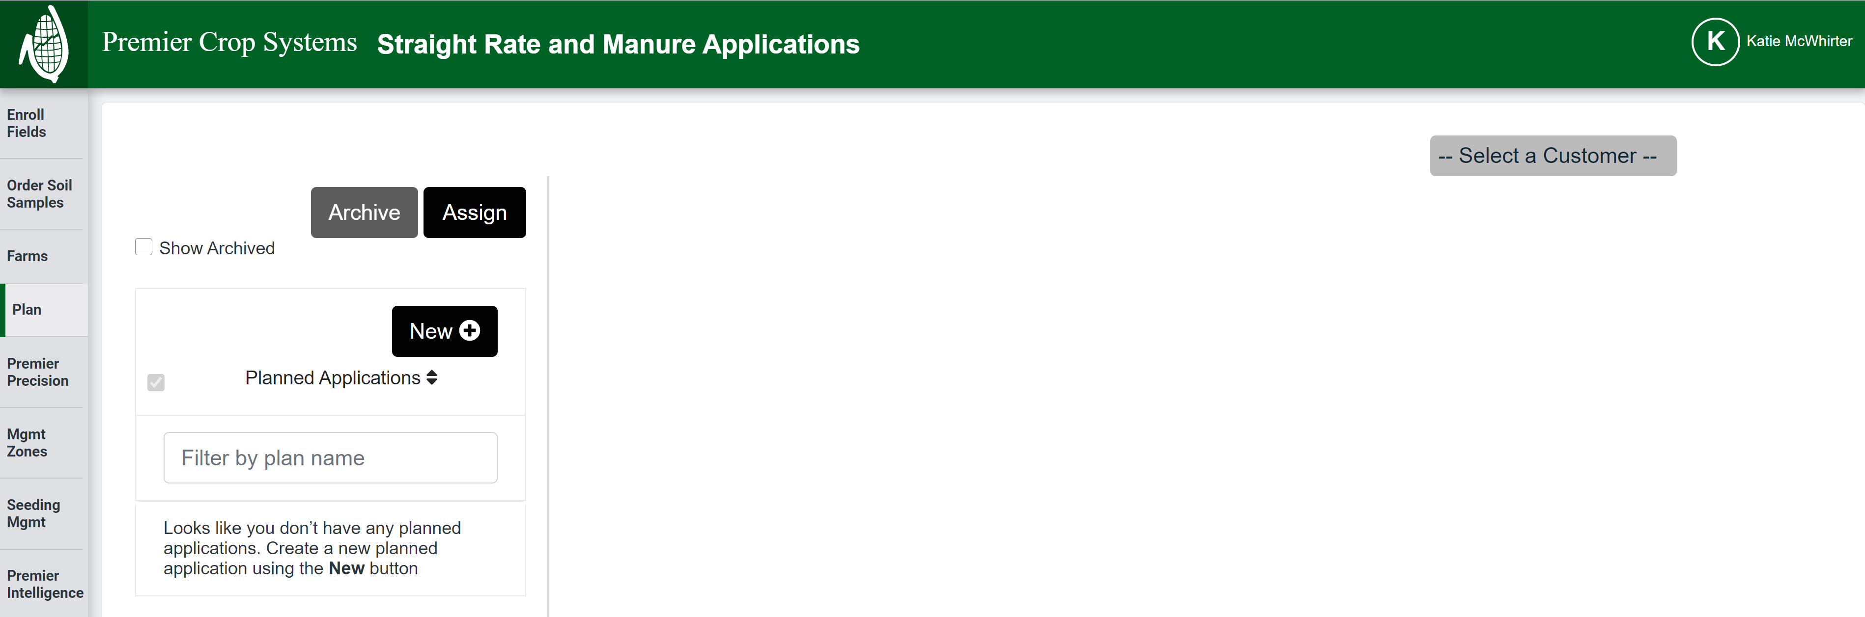

Slide 10
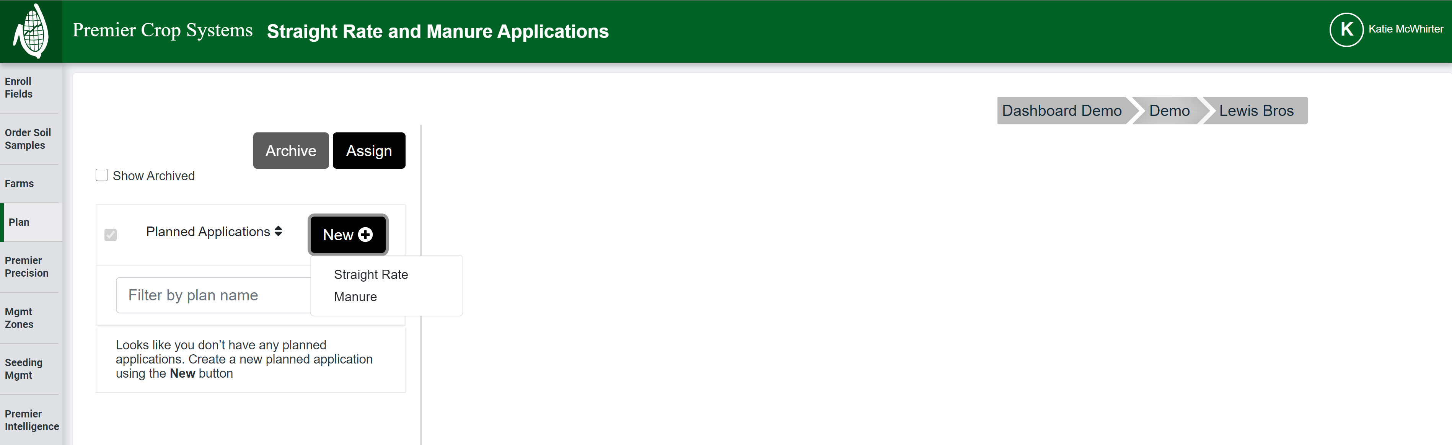

Slide 11
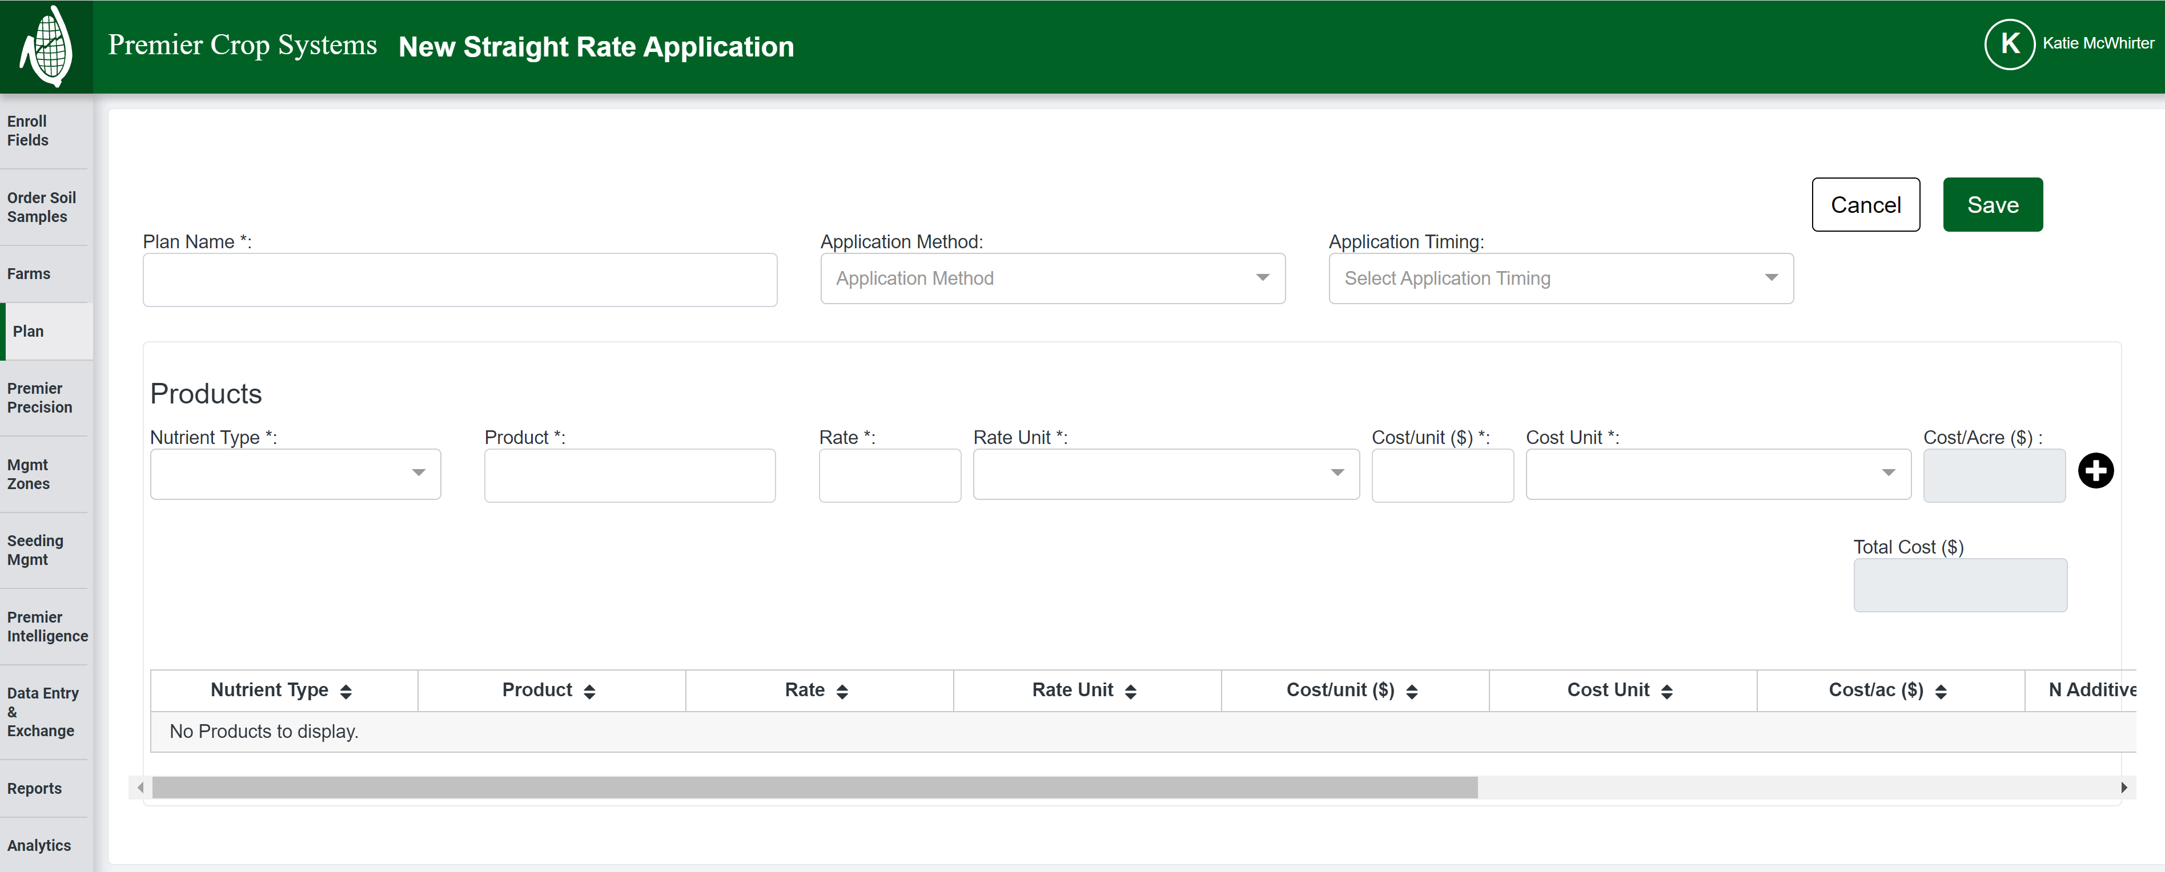

Slide 12
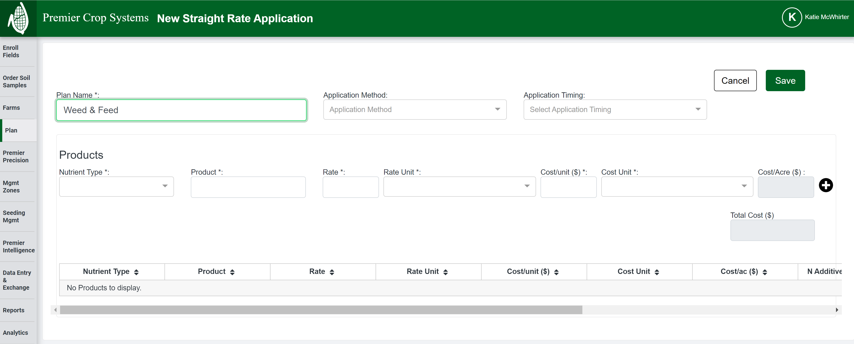

Slide 13
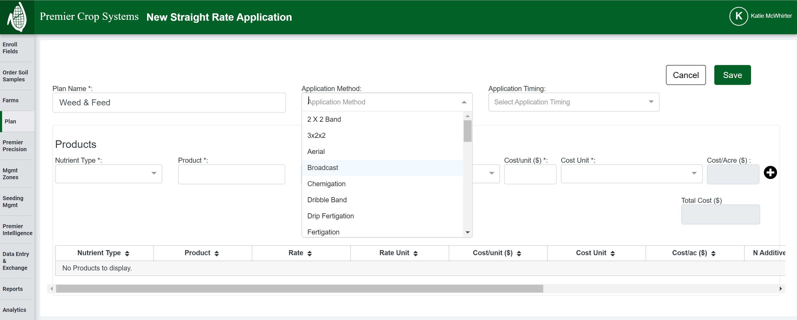

Slide 14
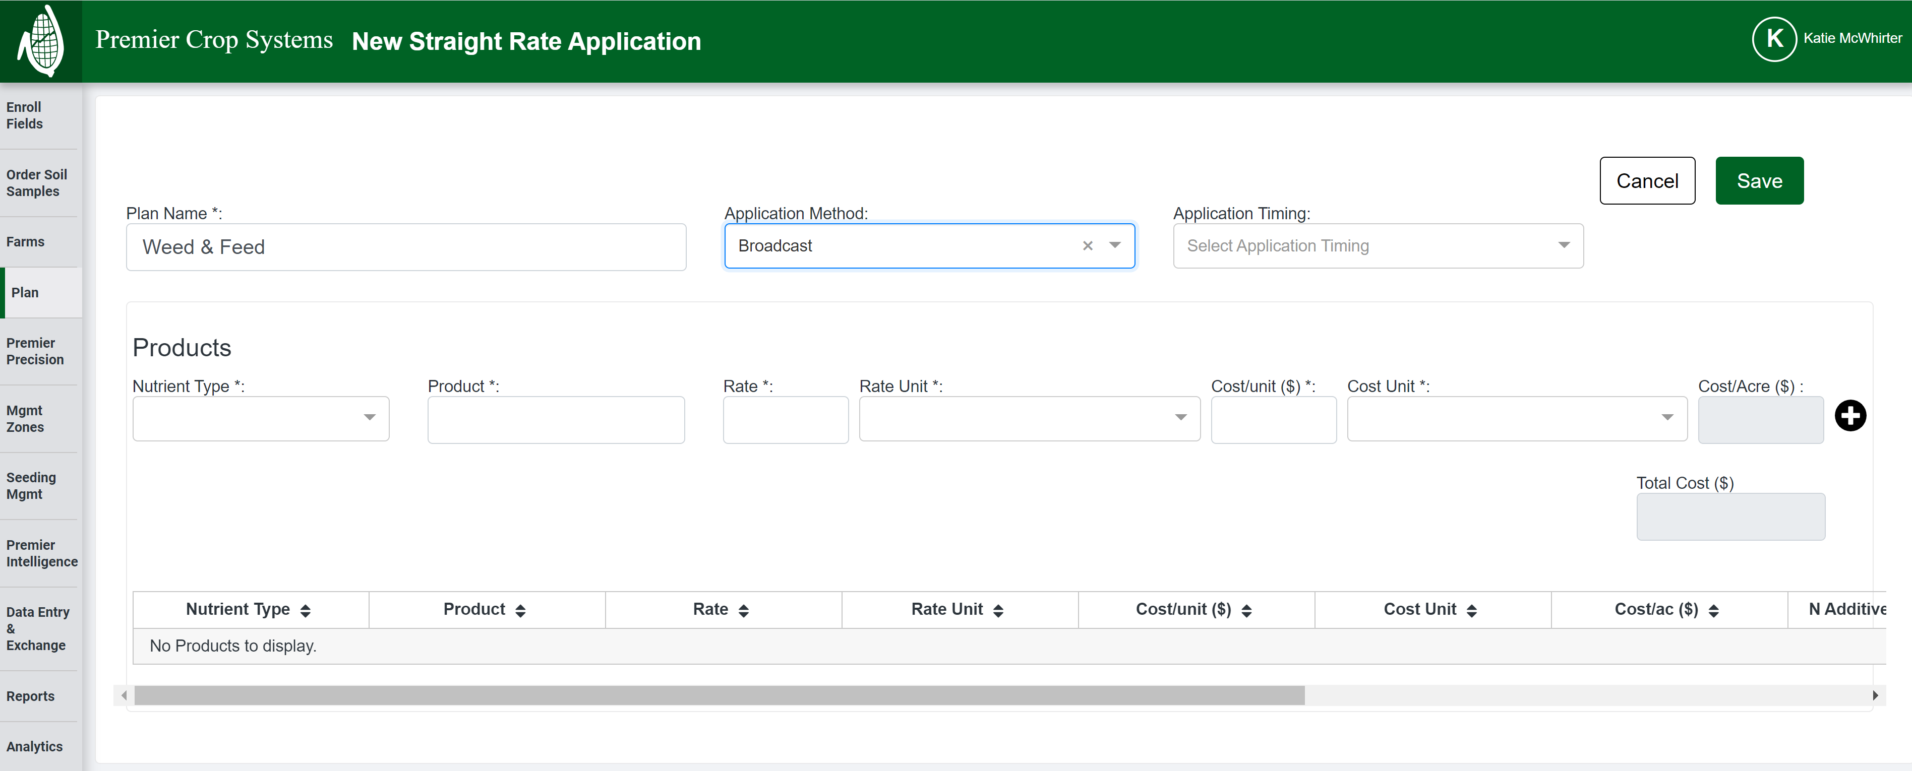

Slide 15
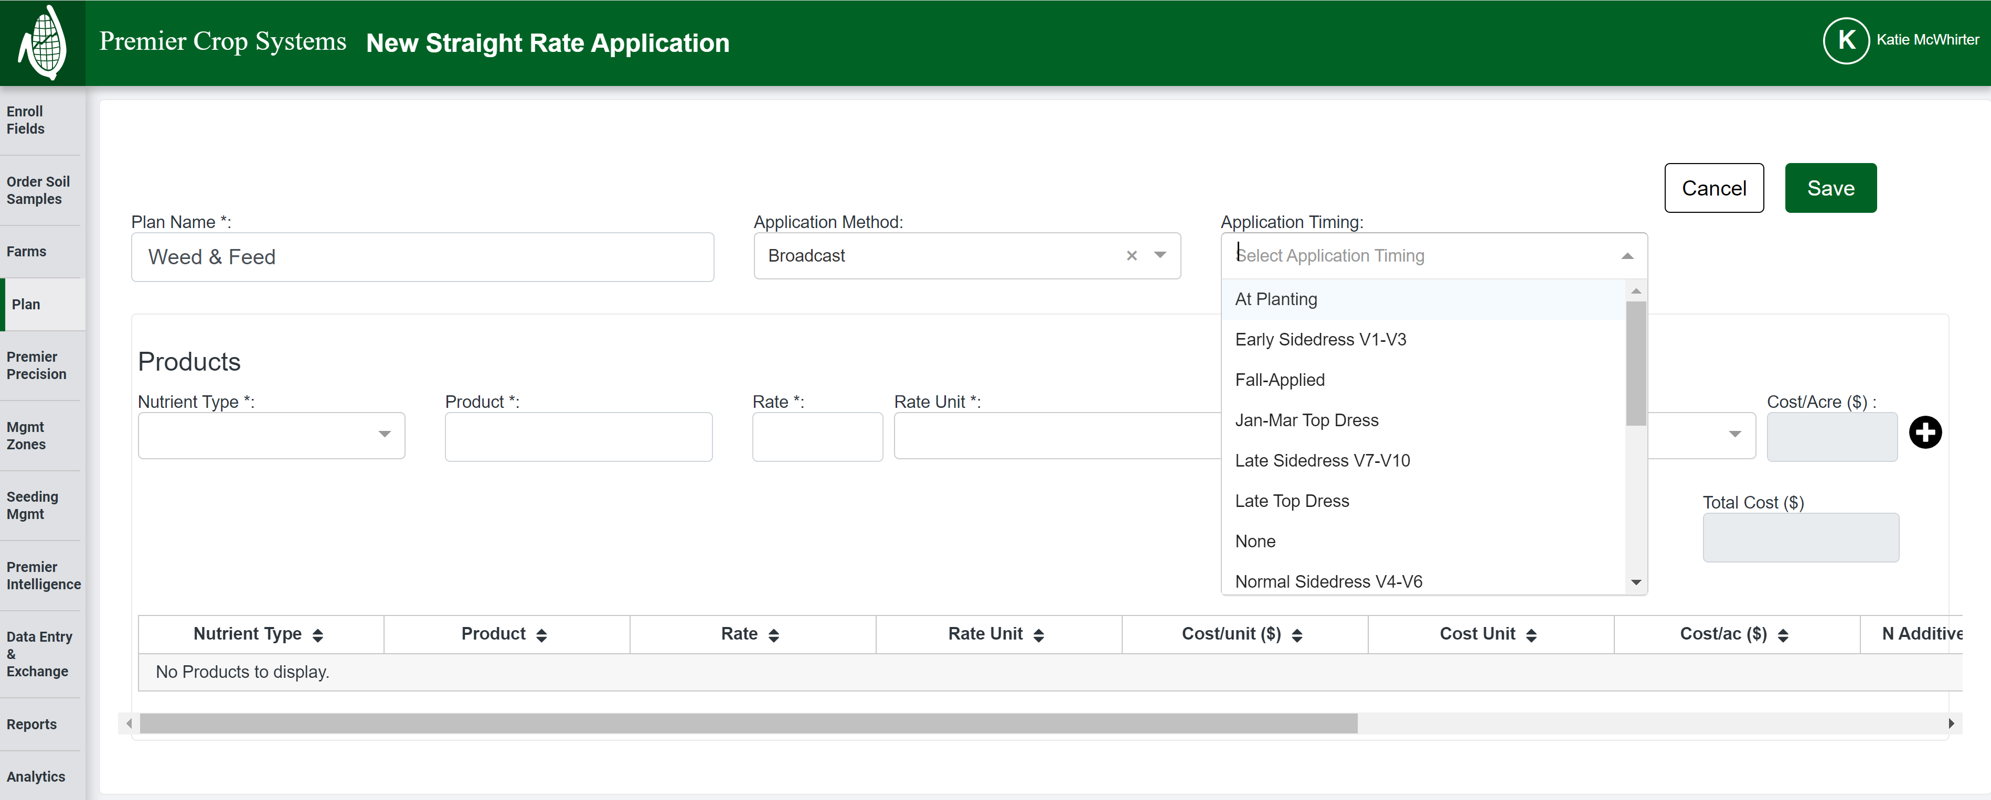

Slide 16
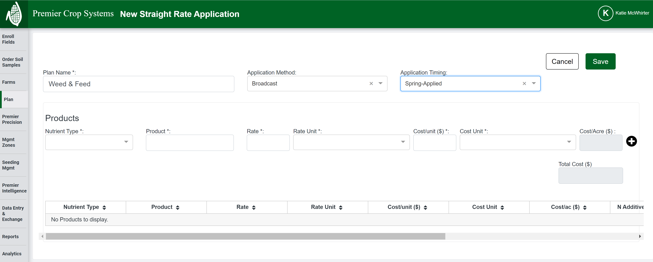

Slide 17
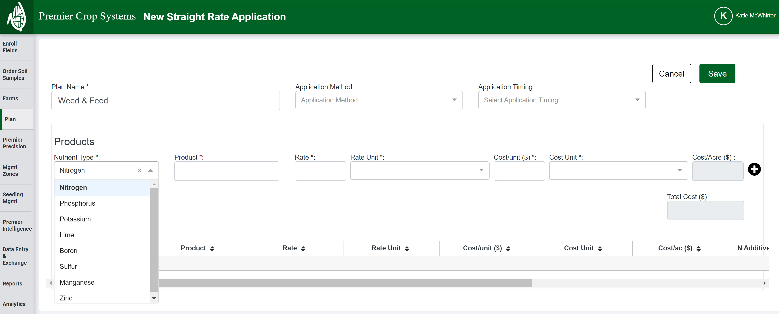

Slide 18
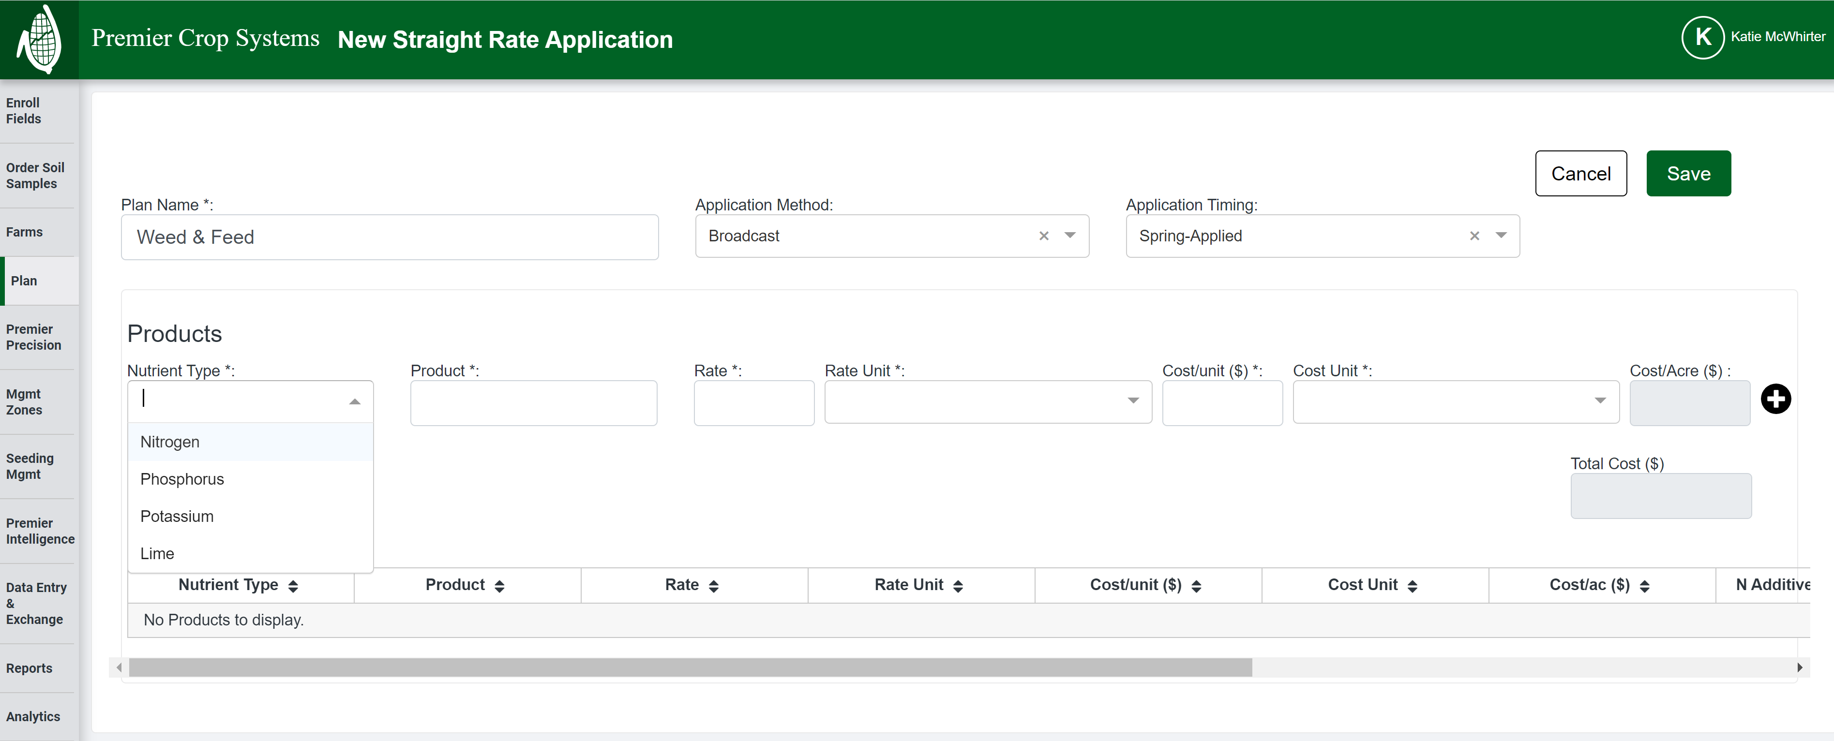
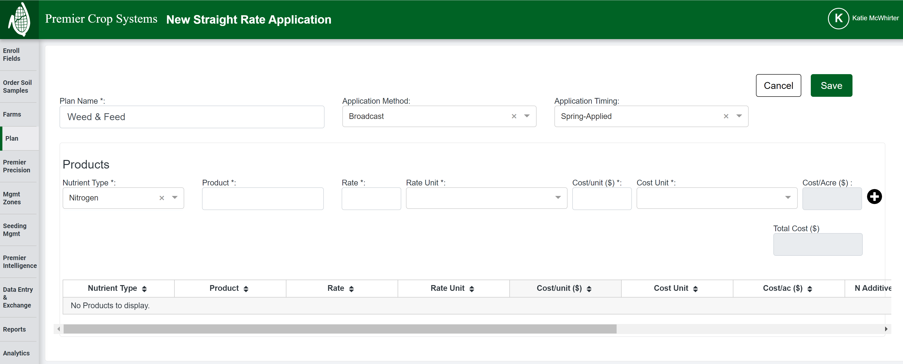

Slide 19
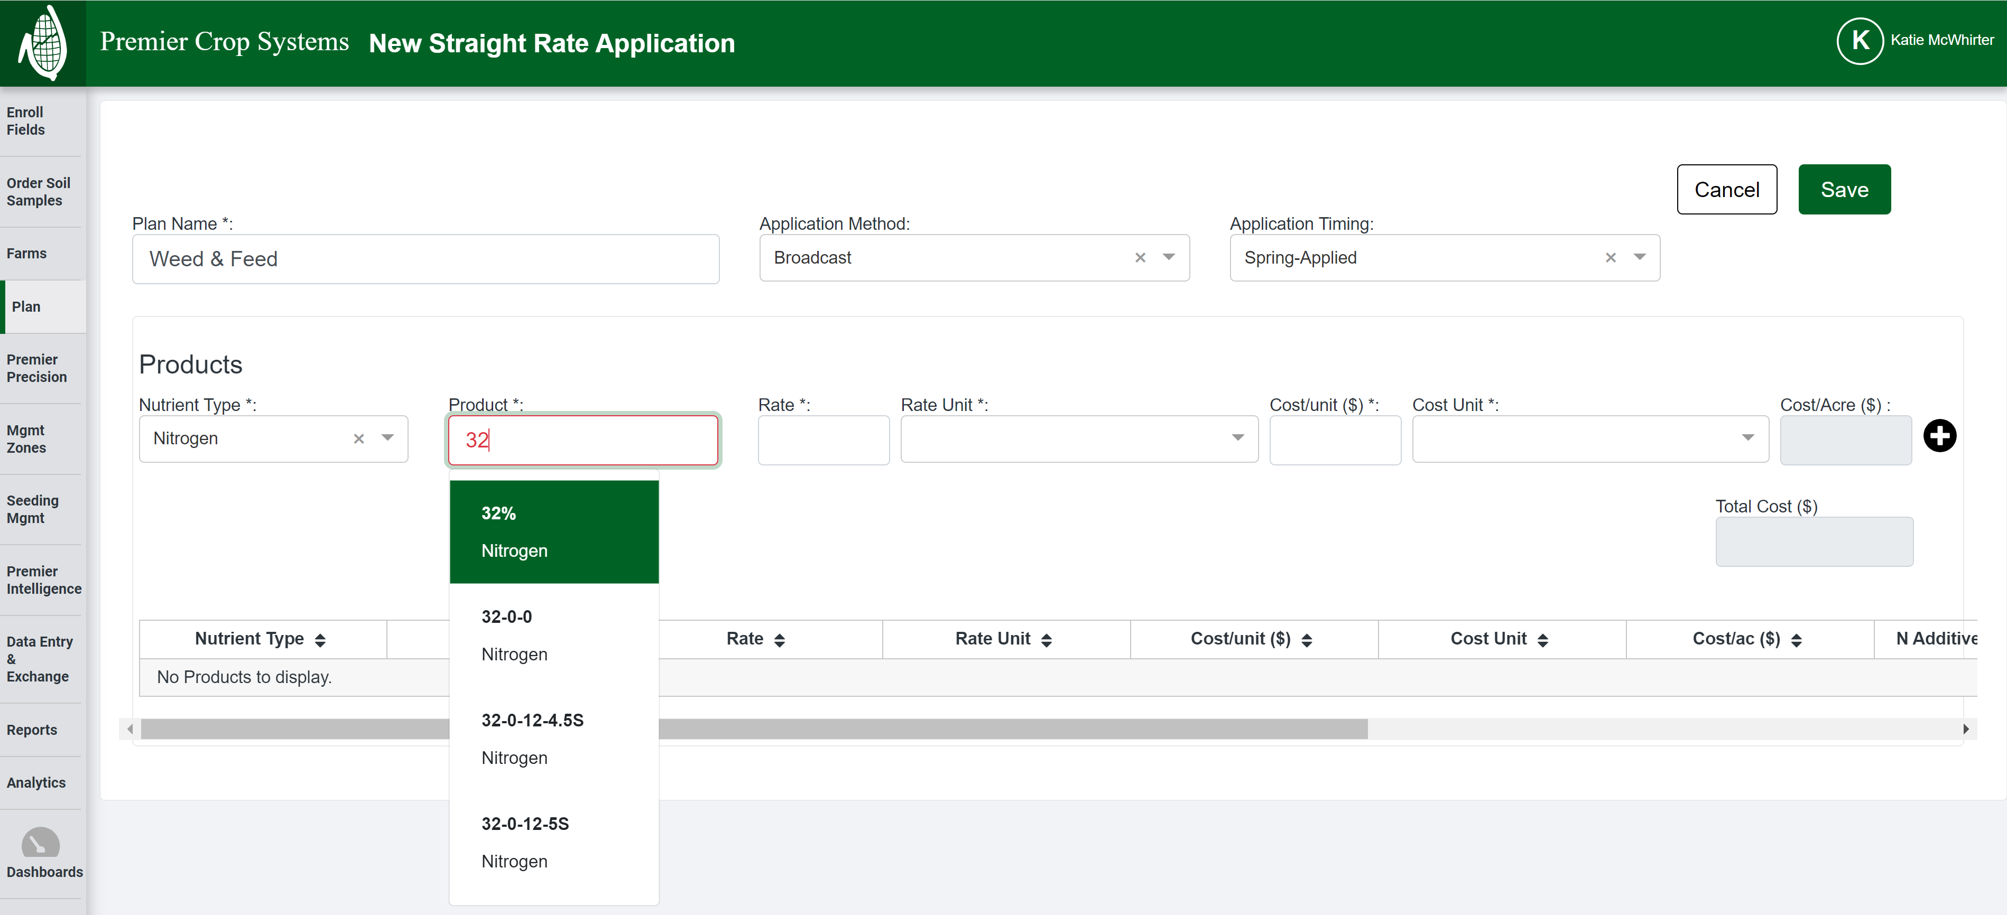

Slide 20
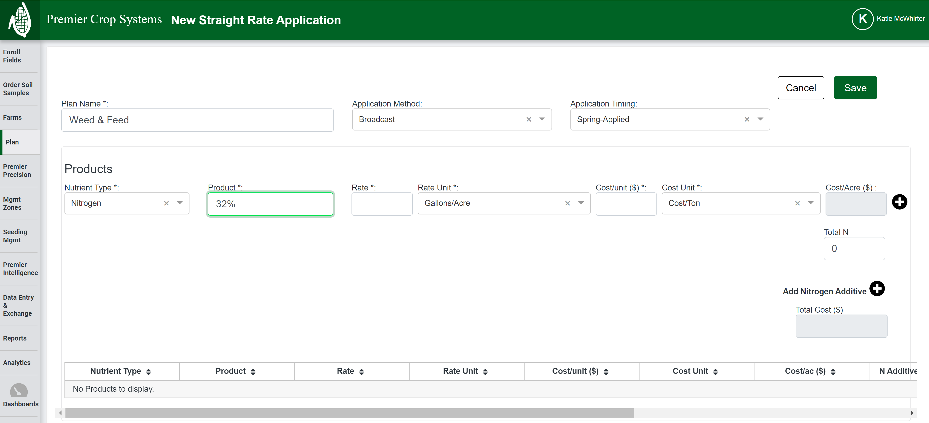

Slide 21
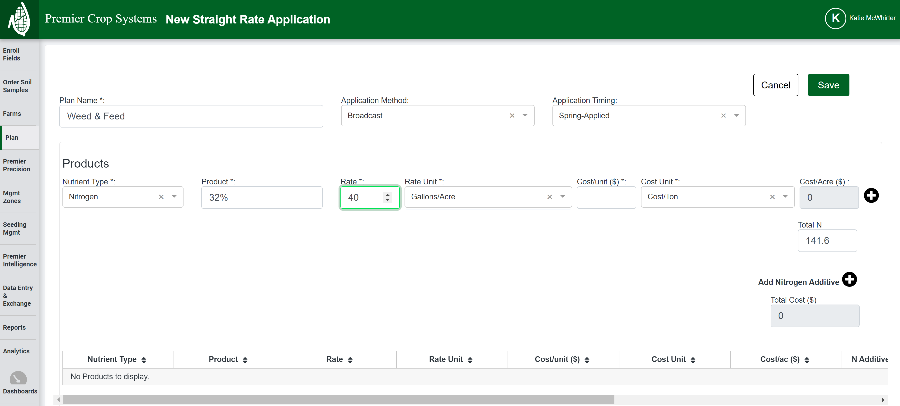

Slide 22
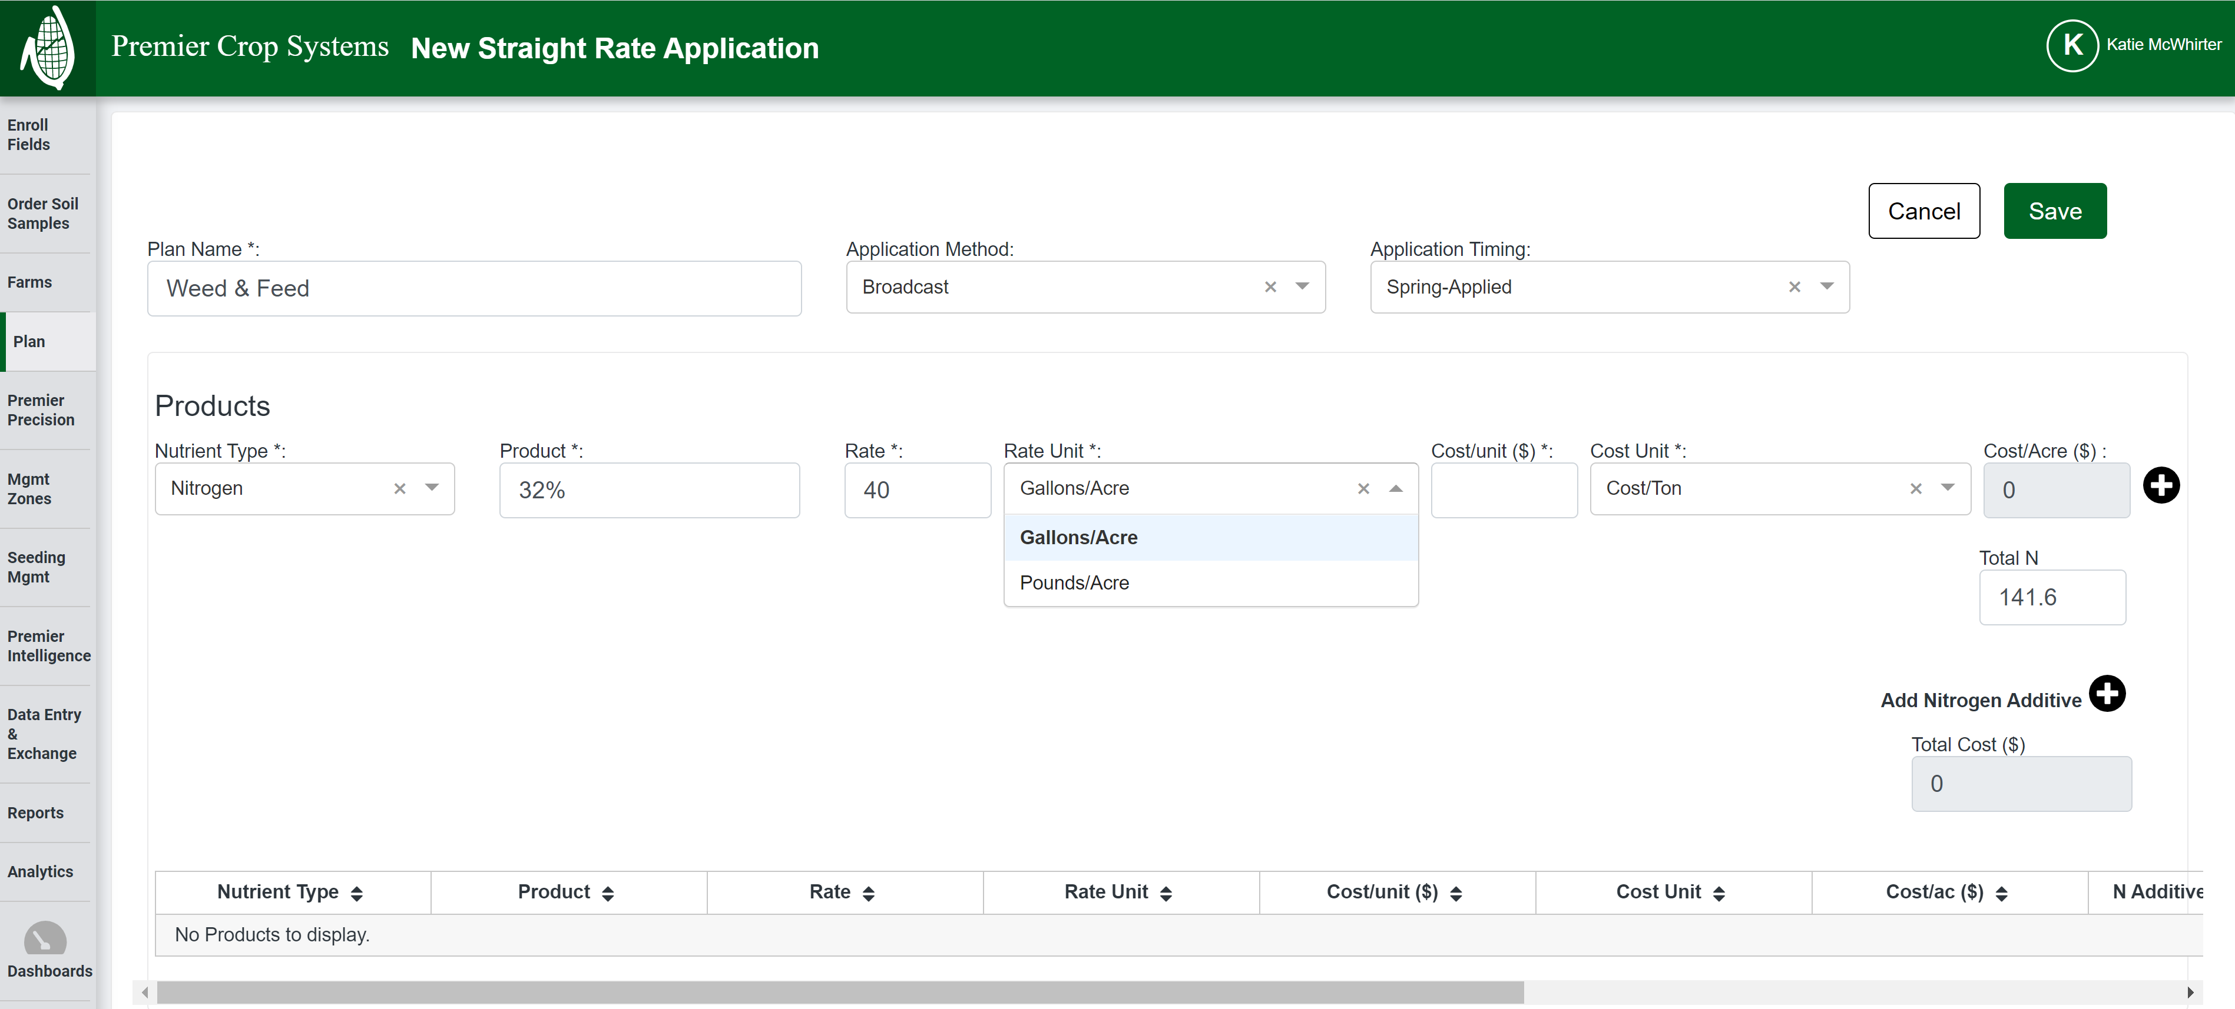

Slide 23
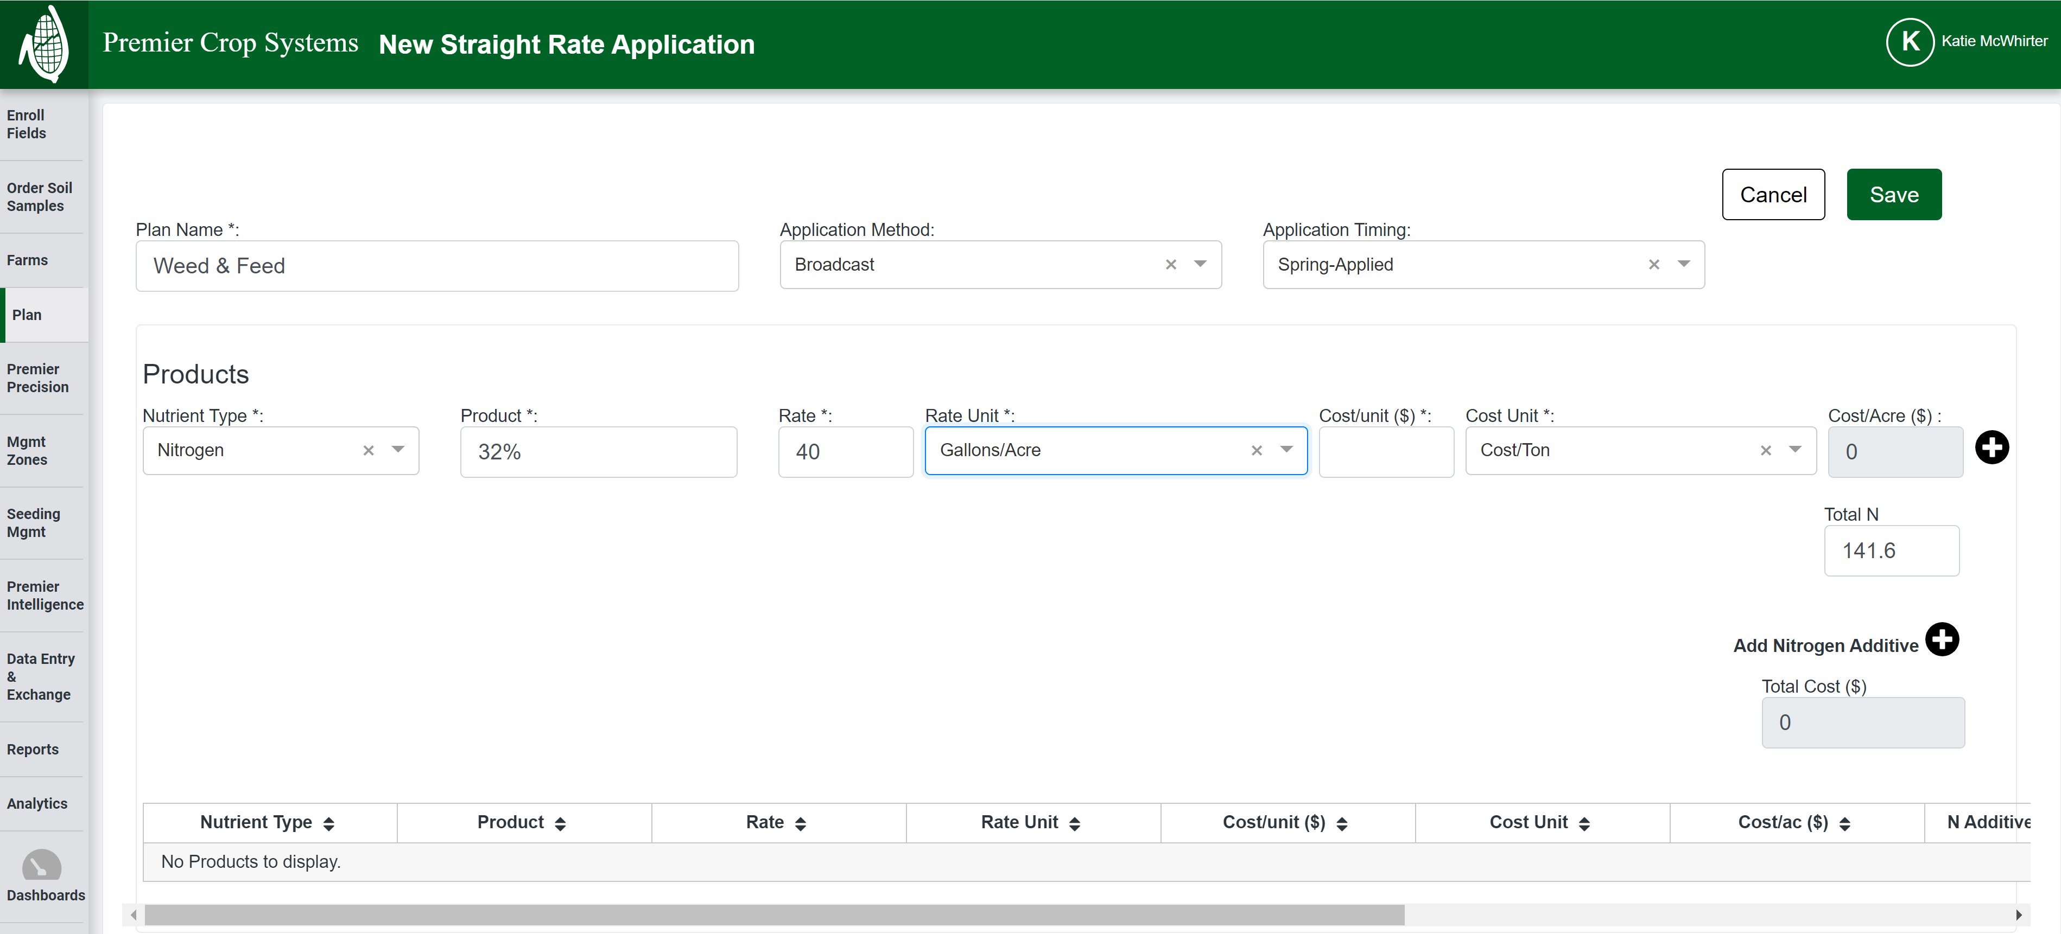

Slide 24
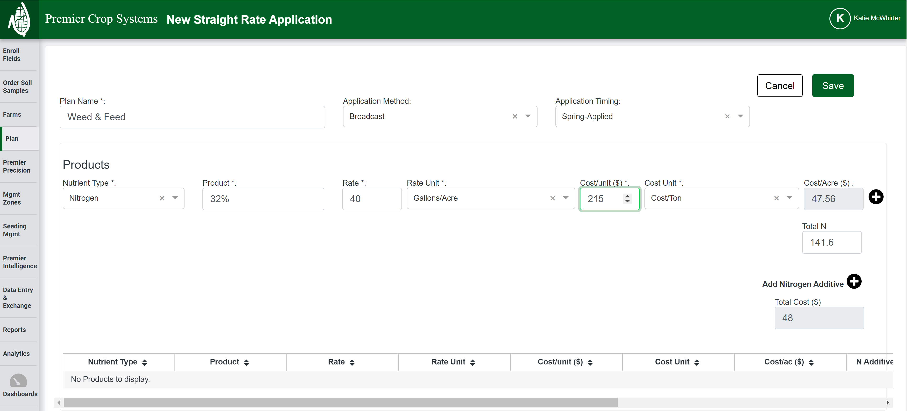

Slide 25
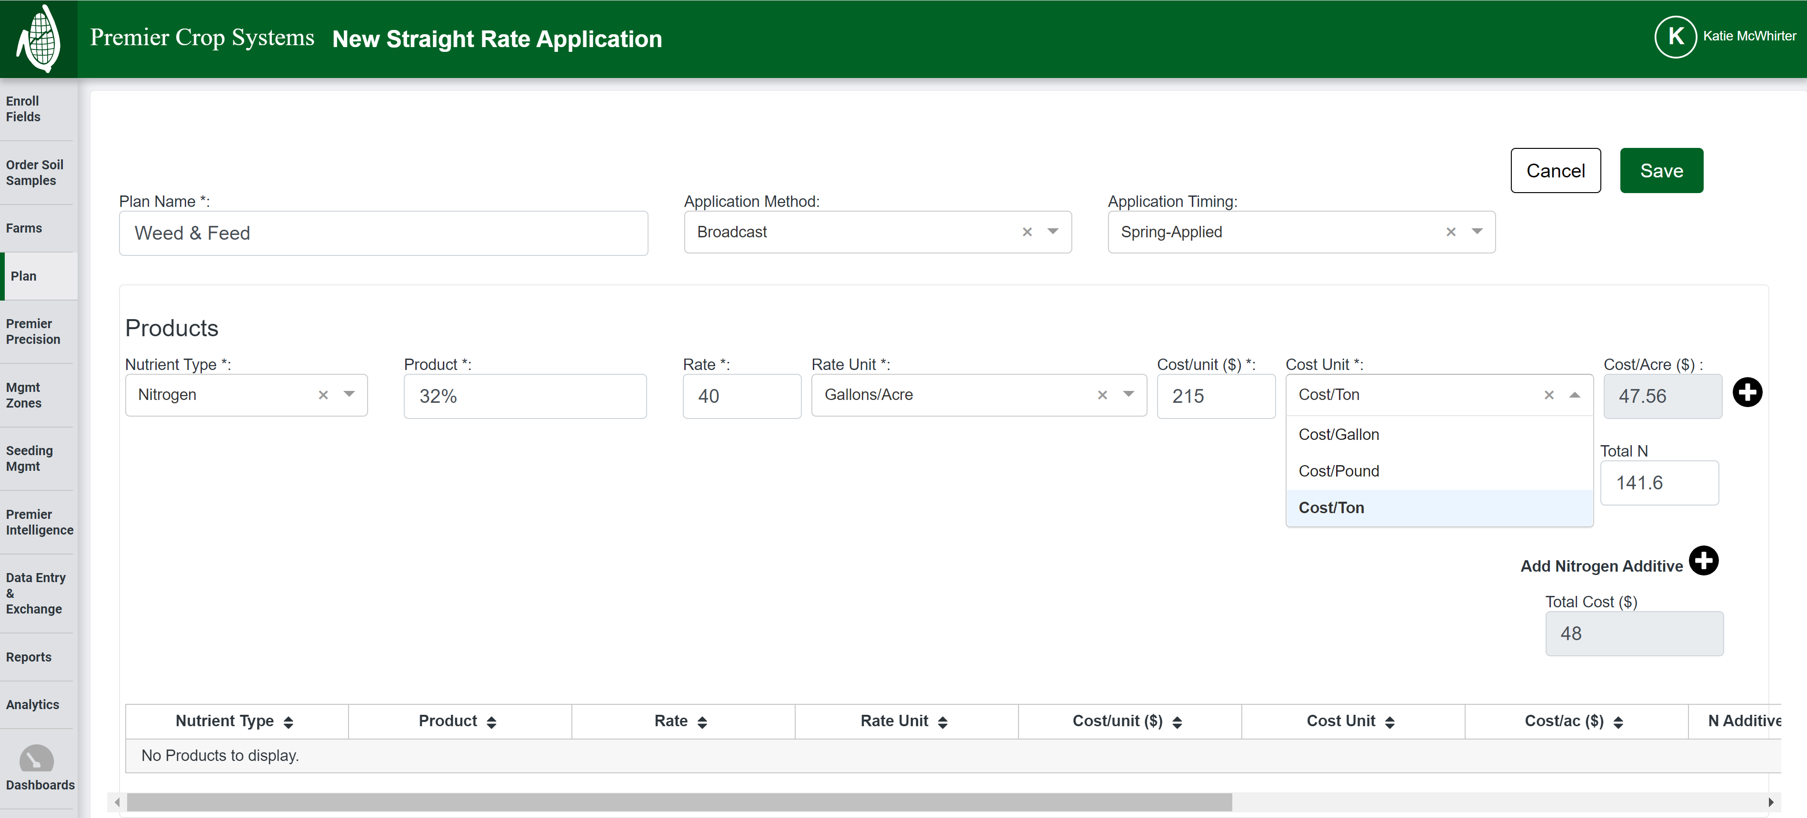

Slide 26
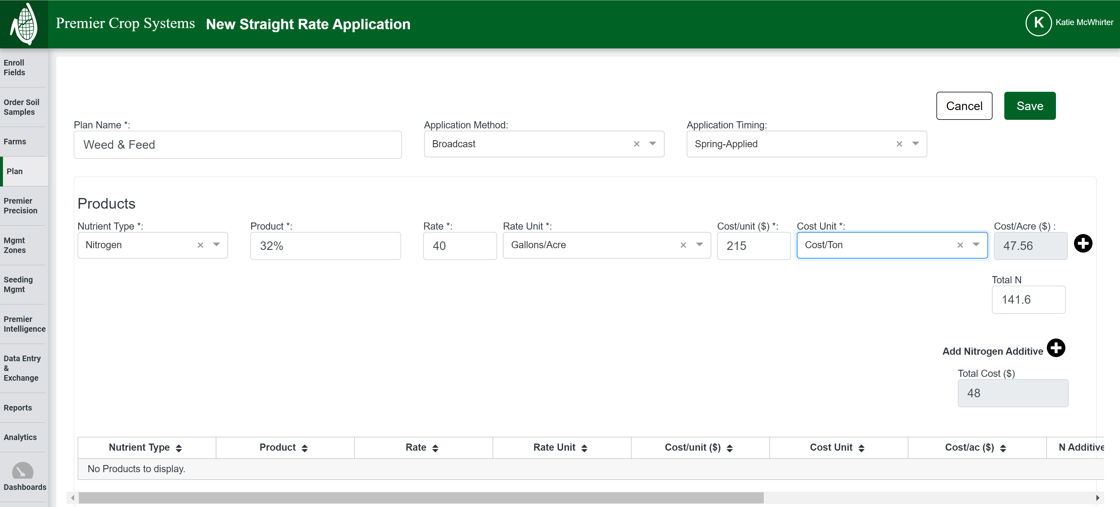

Slide 28
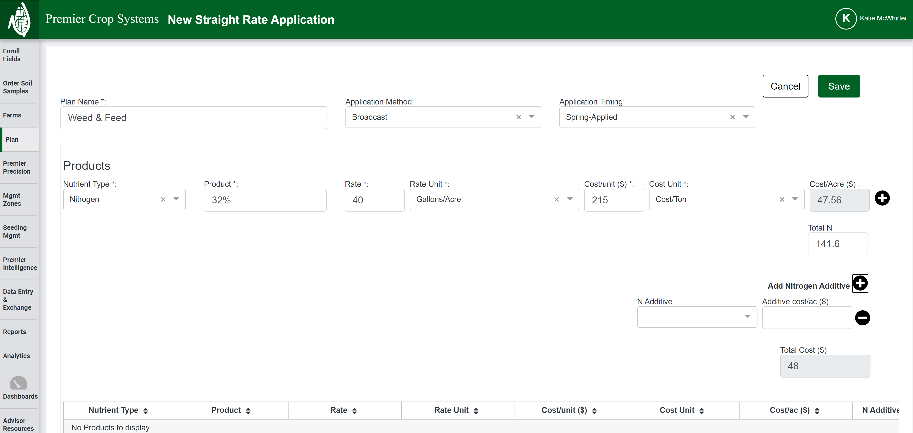

Slide 29
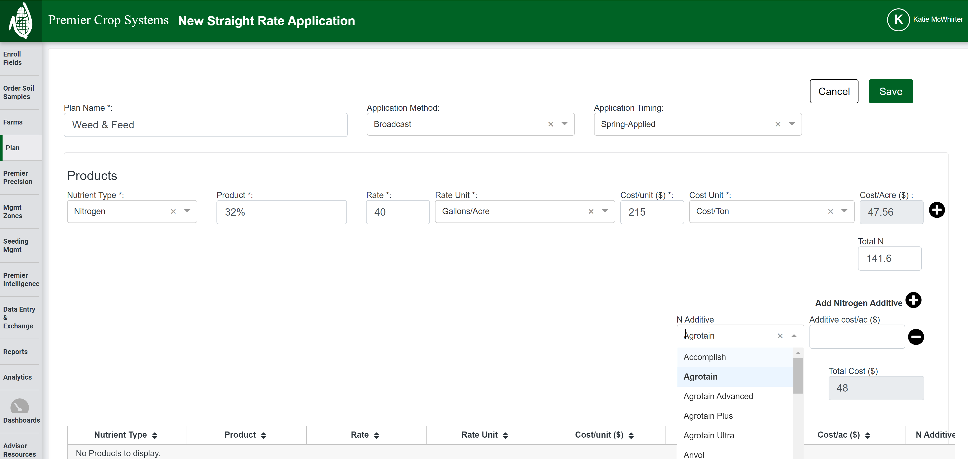

Slide 30
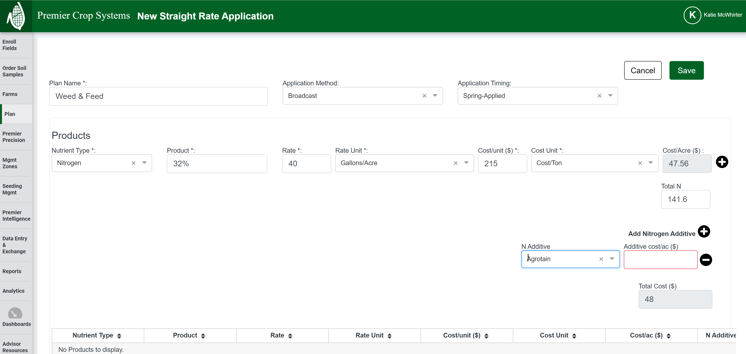

Slide 31


Slide 32
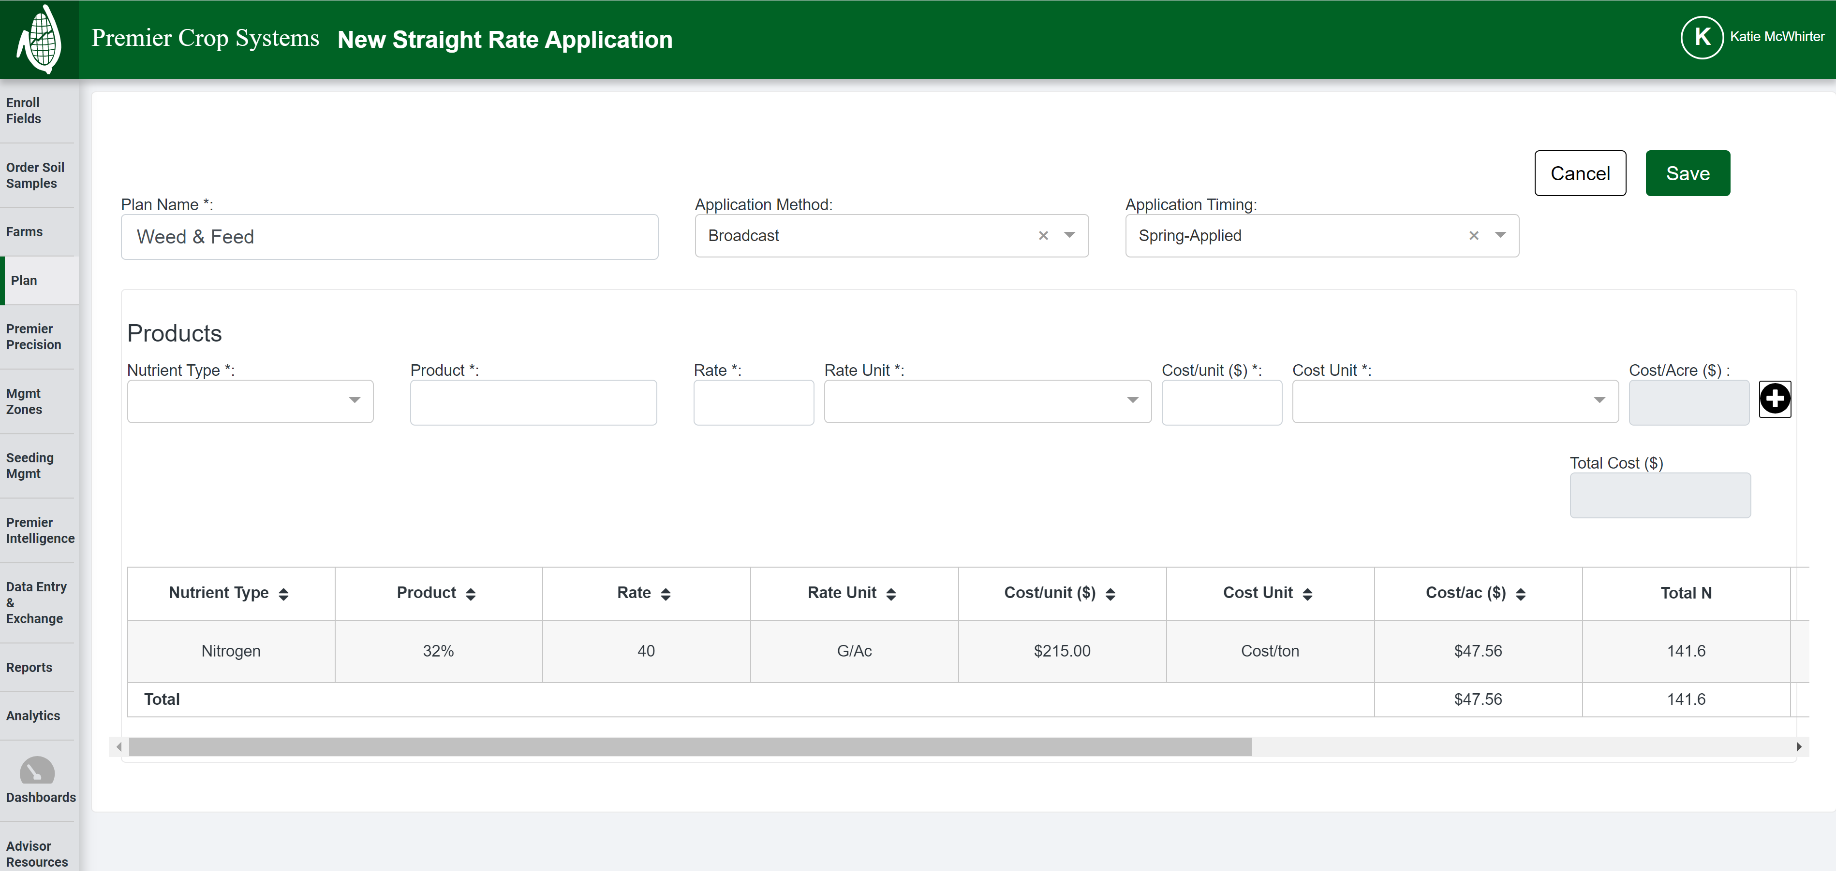

Slide 33
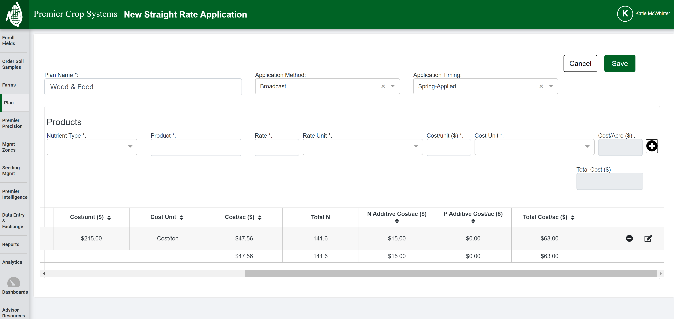

Slide 34
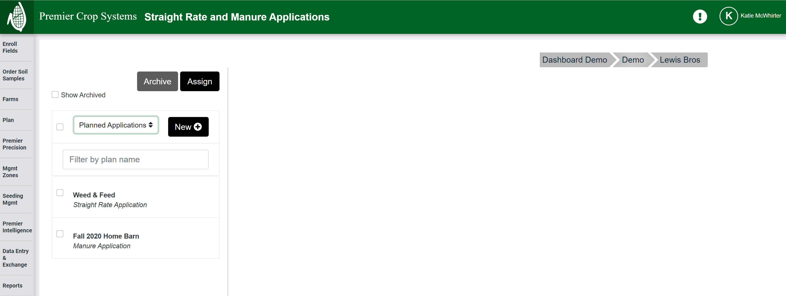

Slide 35
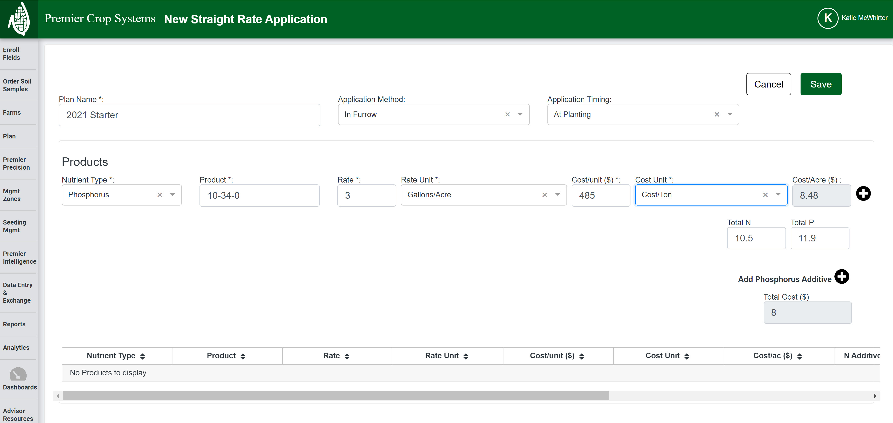
3.5

Slide 36
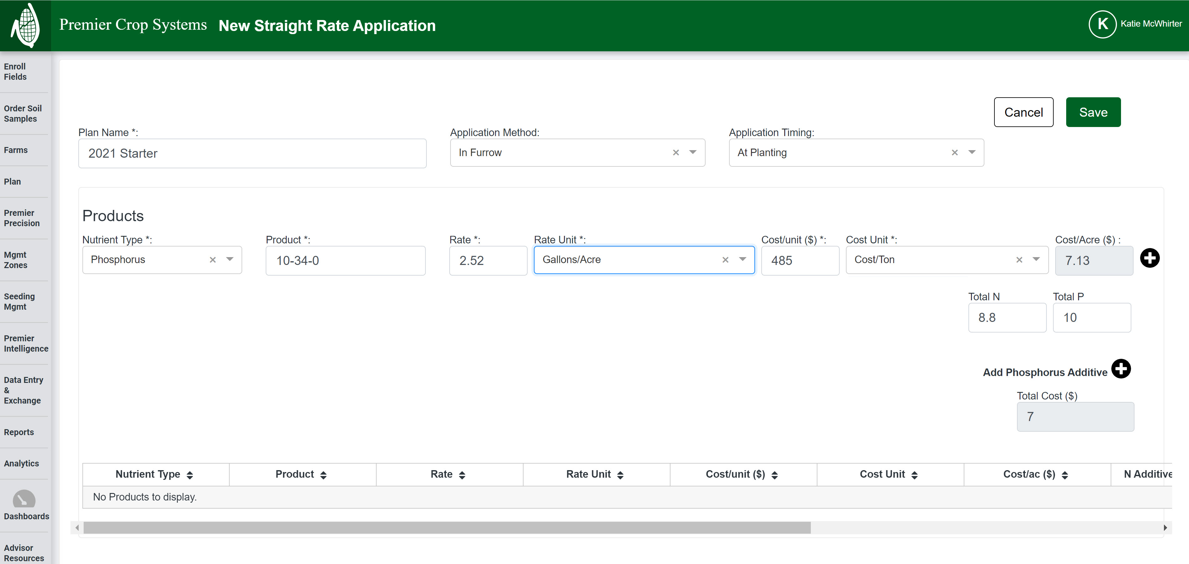
2.9

Slide 37
QUESTIONS?
Moving on to Manure!

Slide 40
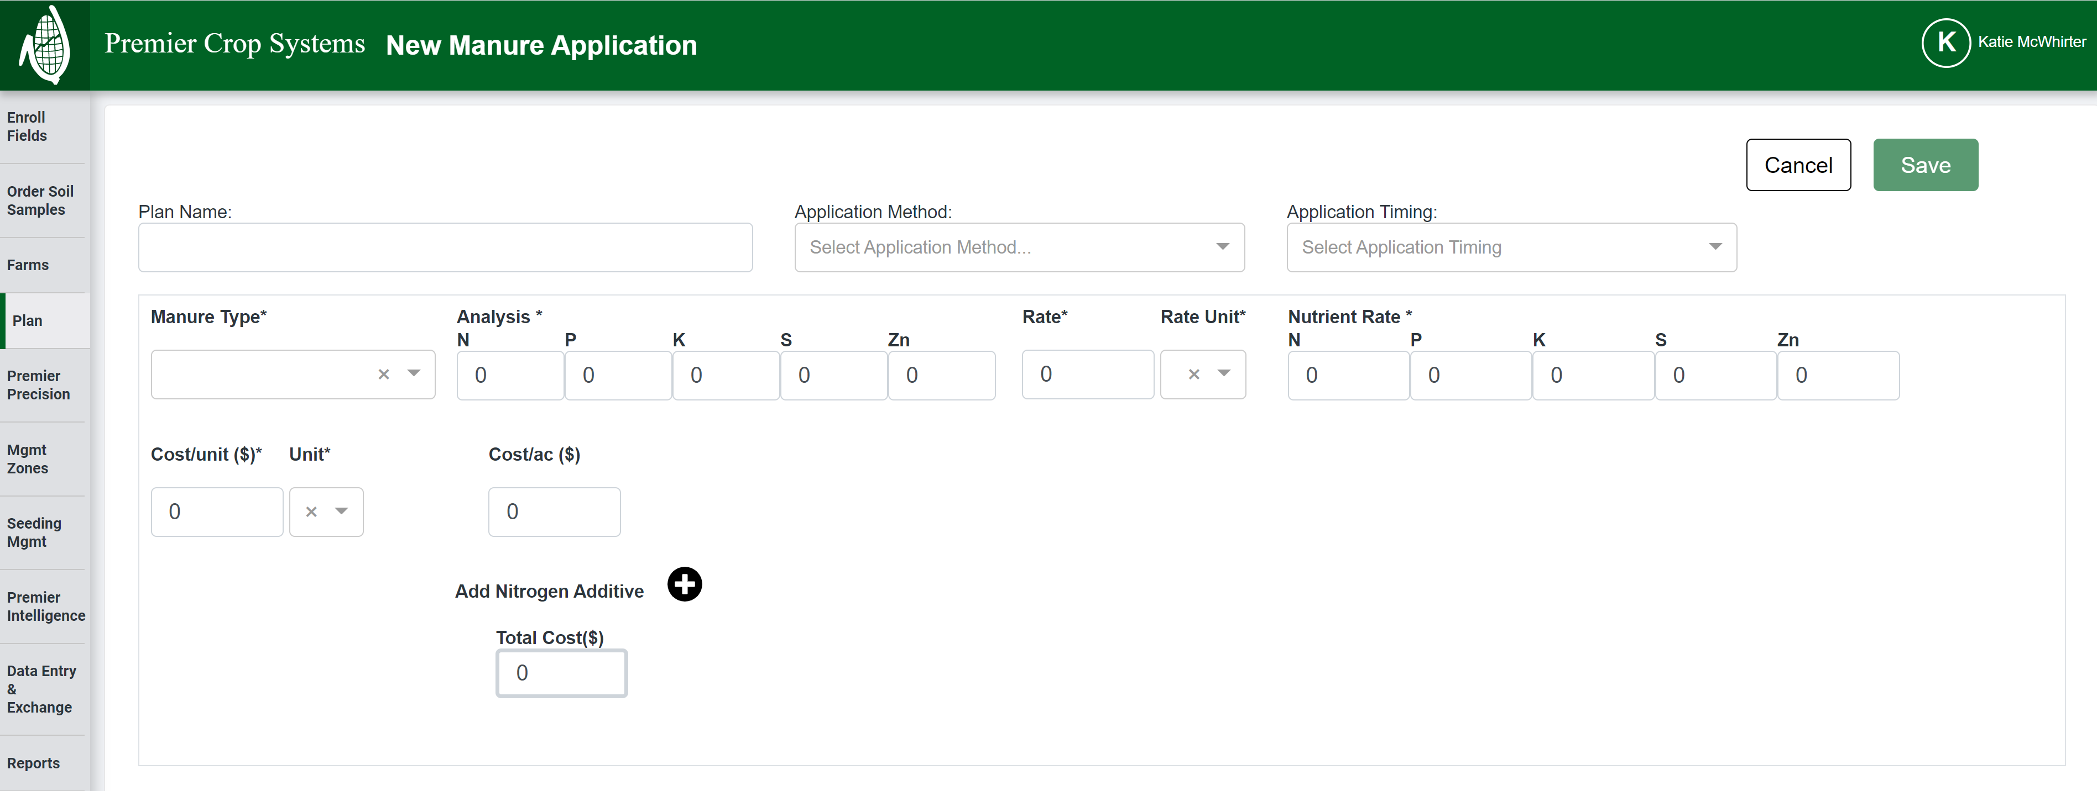

Slide 41
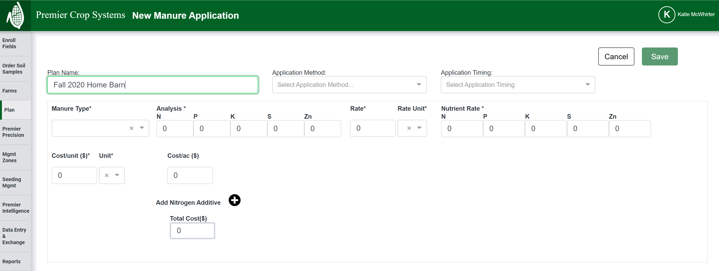

Slide 42
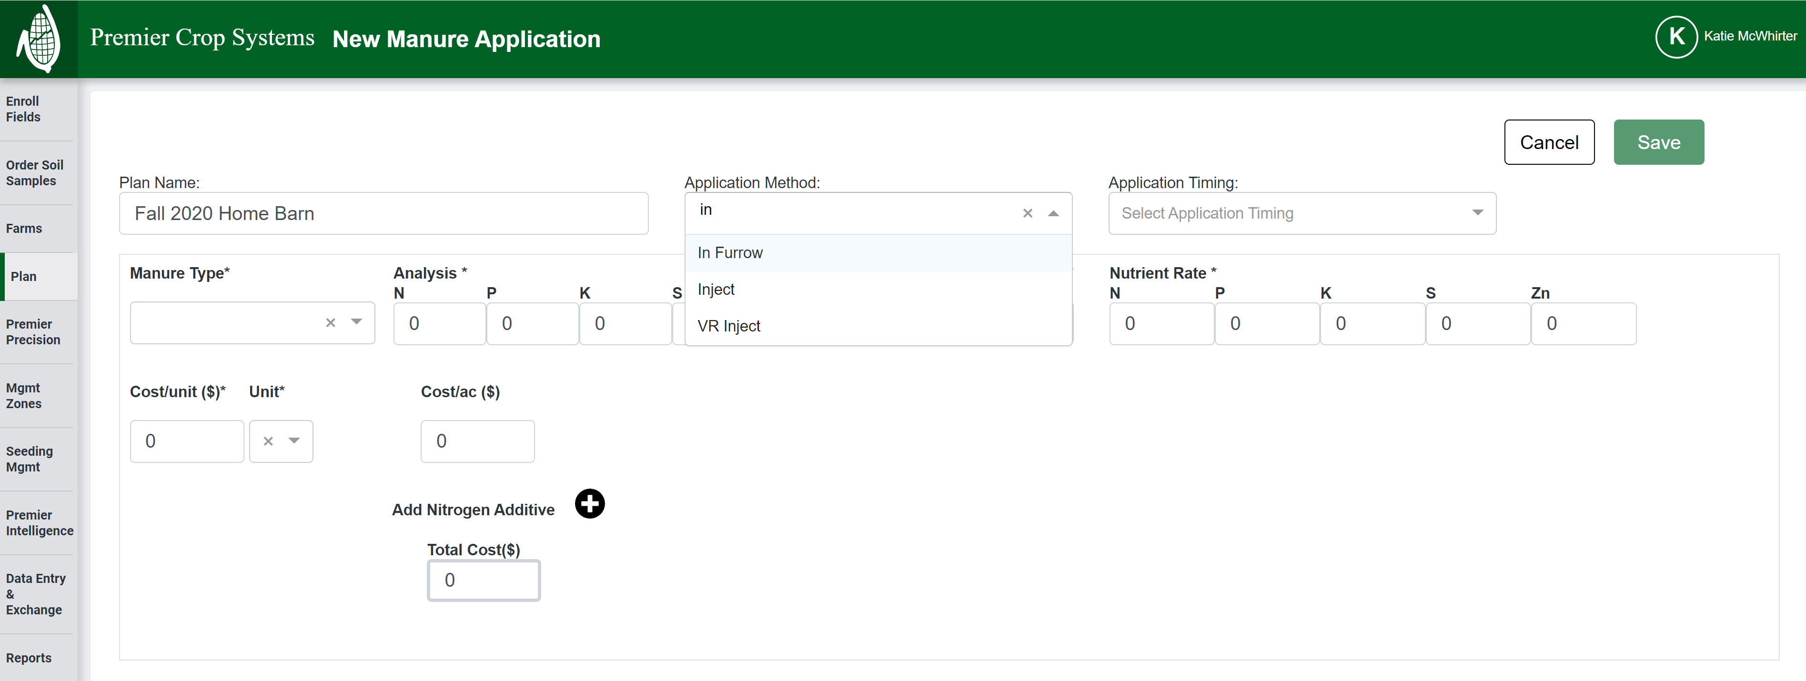

Slide 43
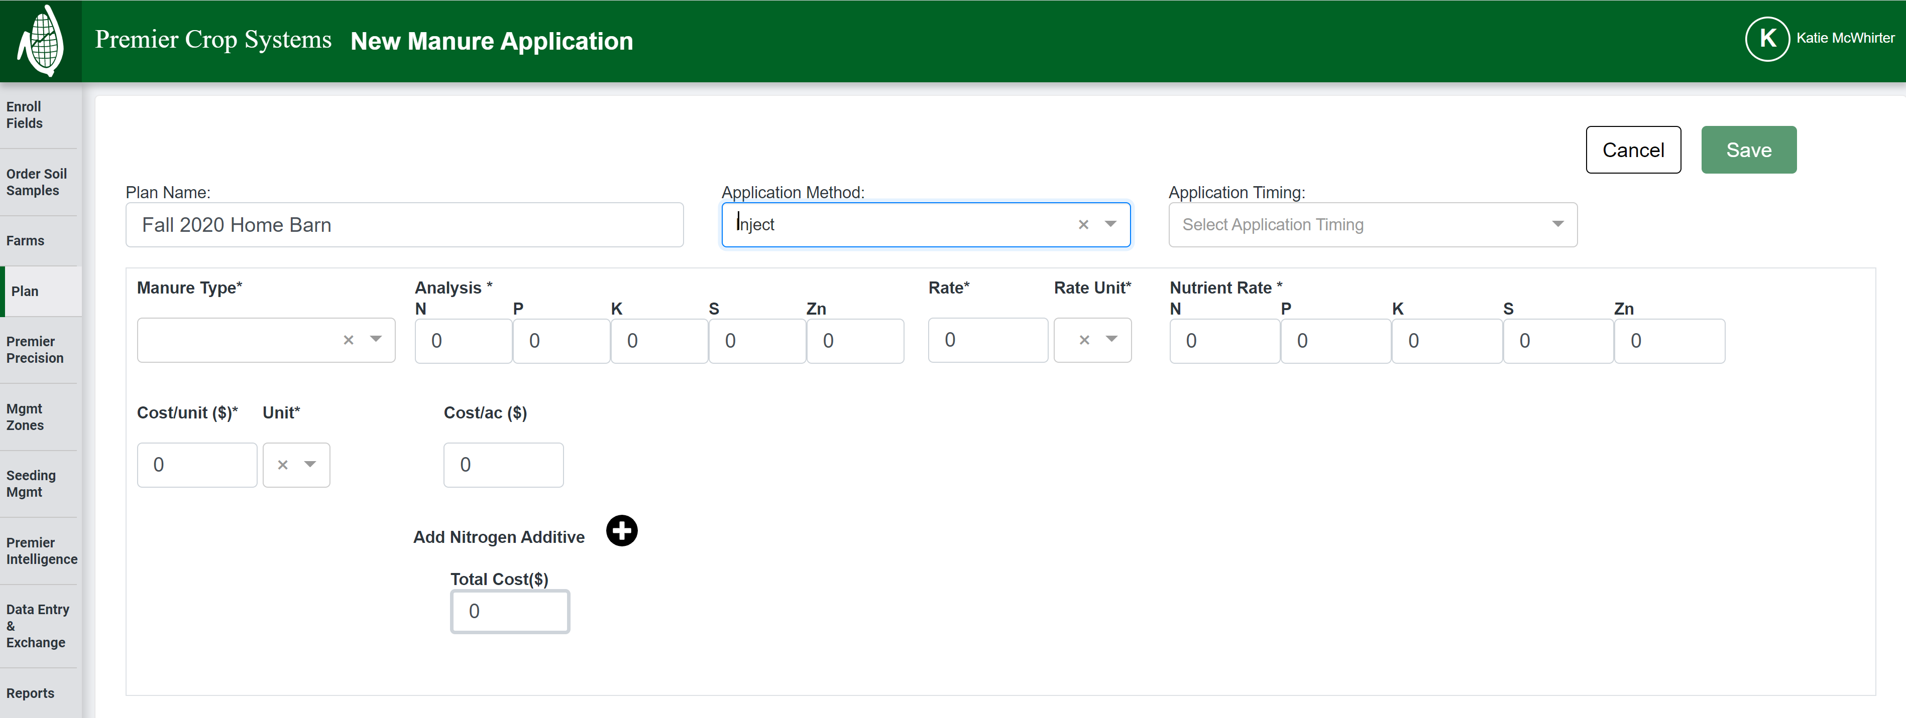

Slide 44
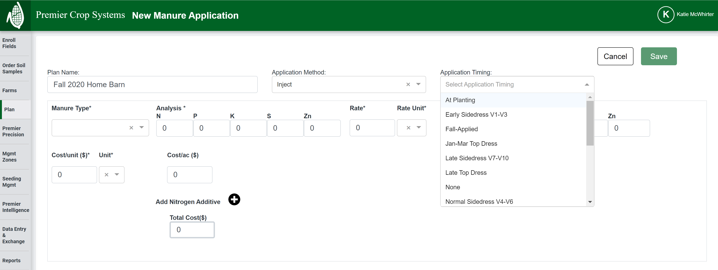

Slide 45
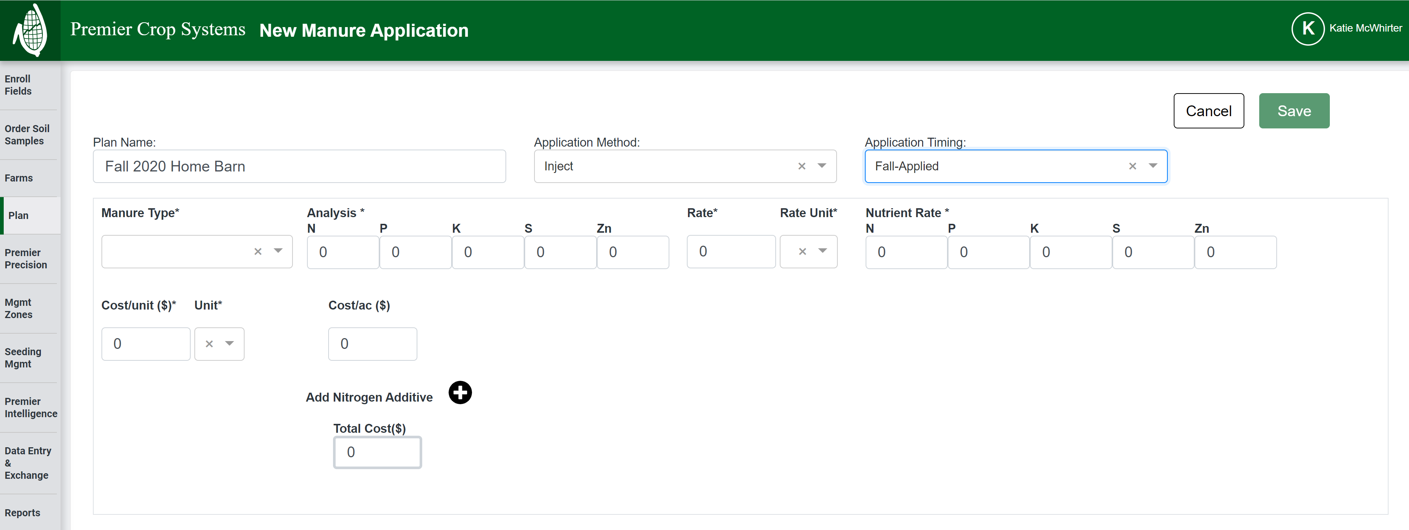

Slide 46
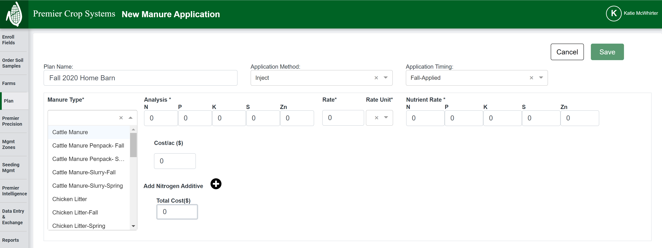

Slide 47
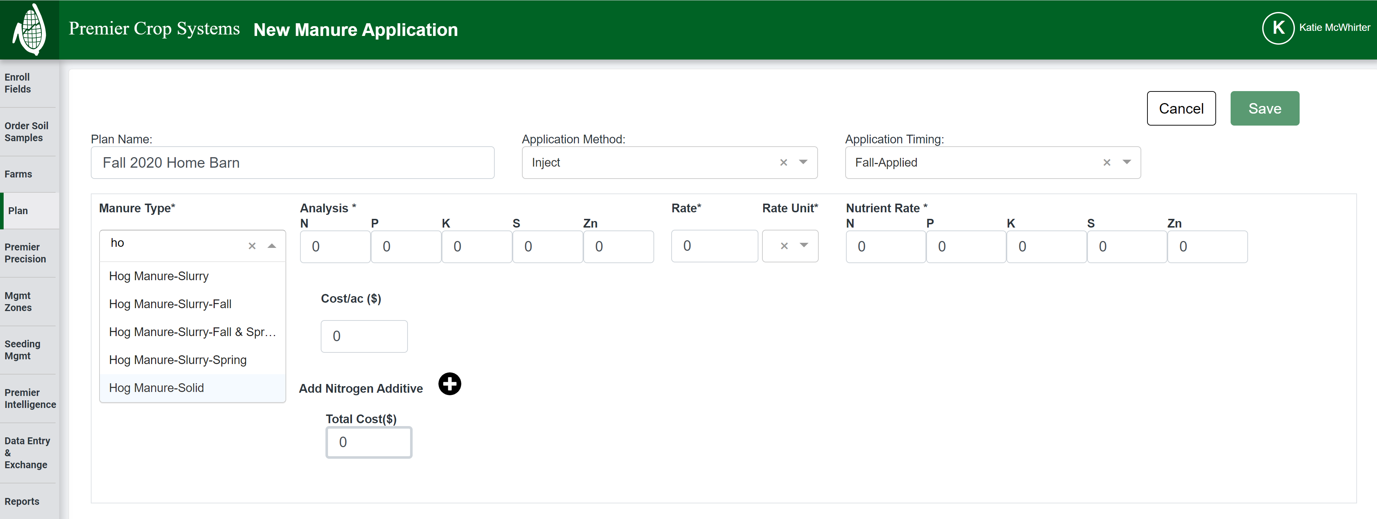

Slide 48
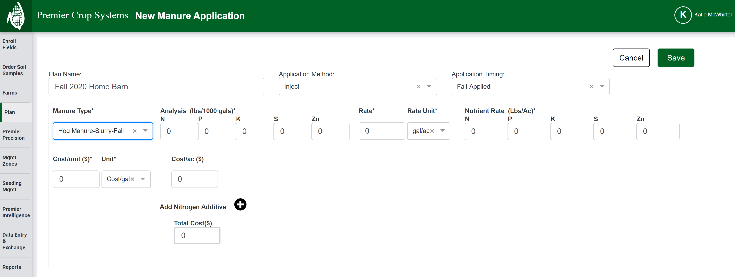

Slide 49
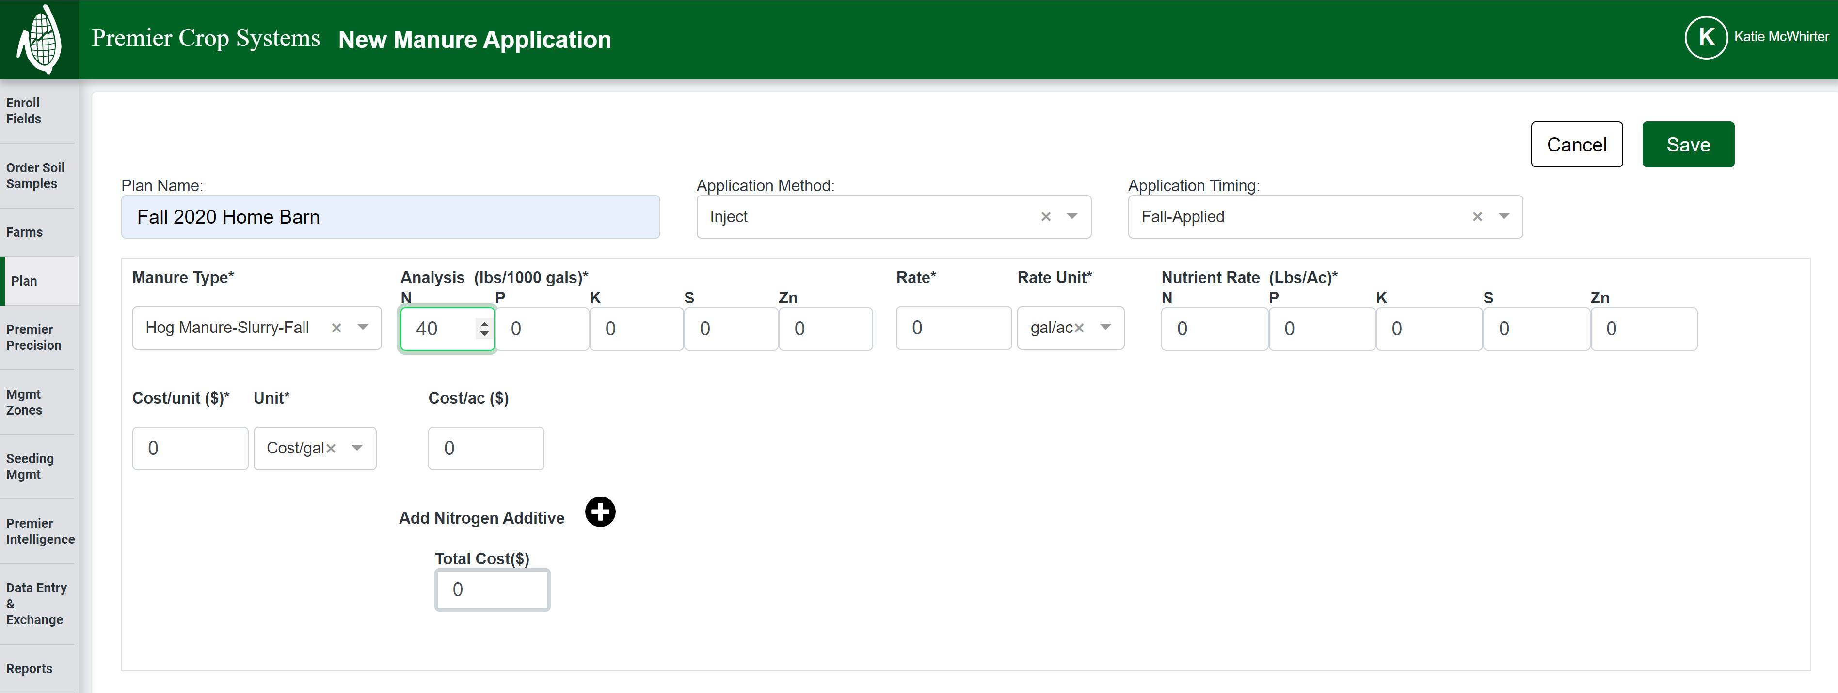

Slide 50
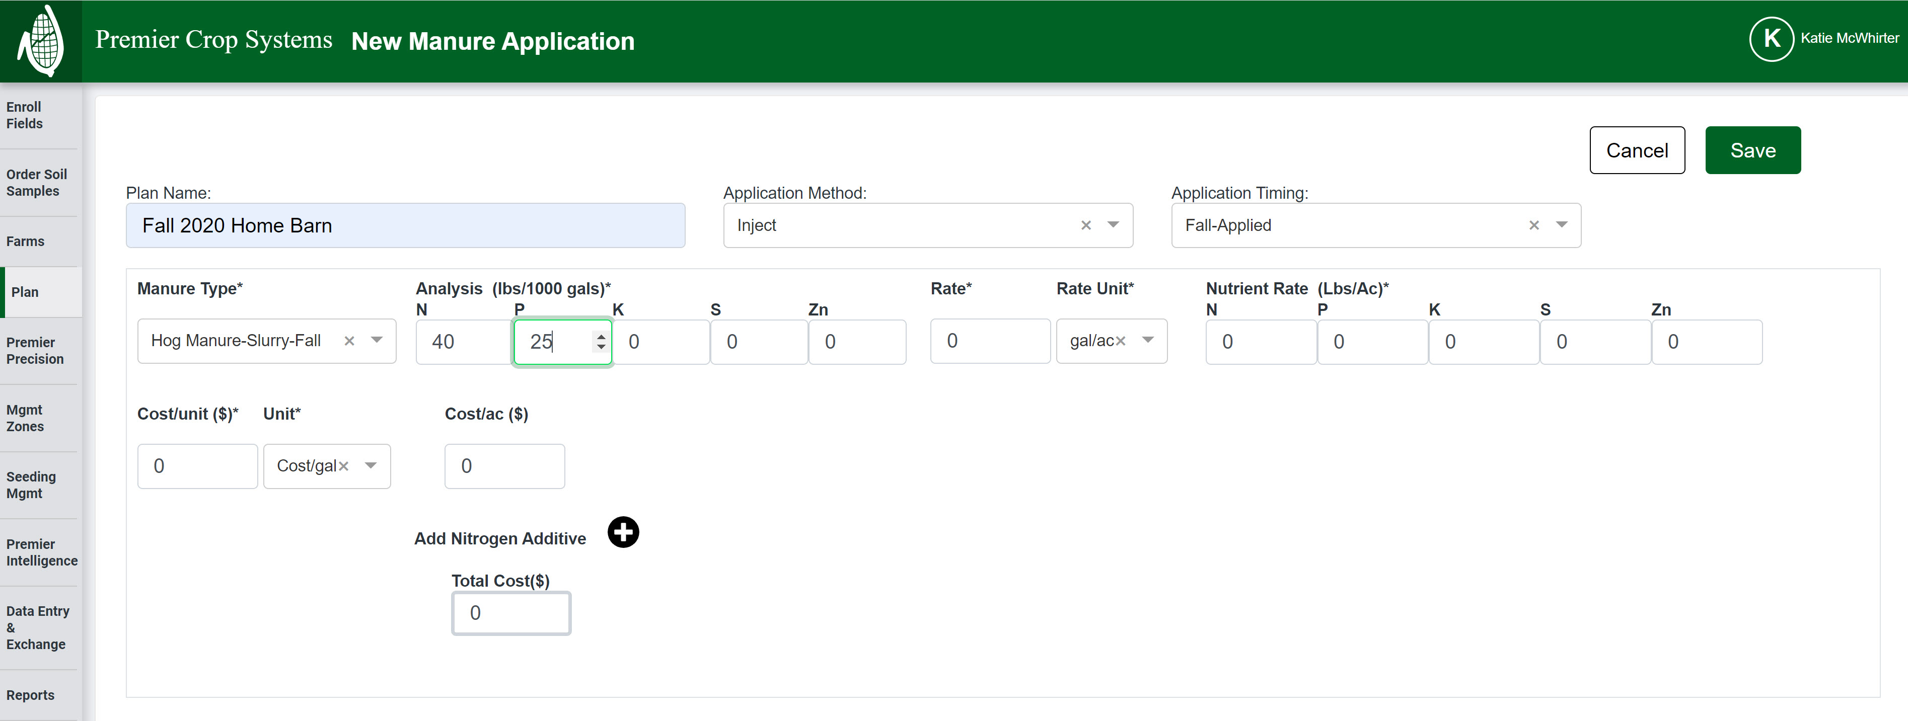

Slide 51
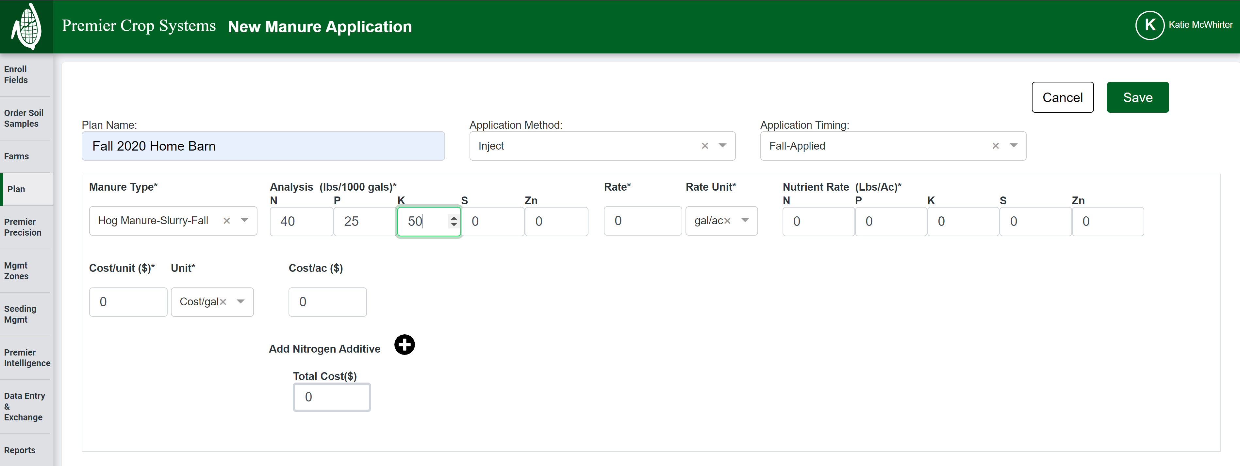

Slide 52
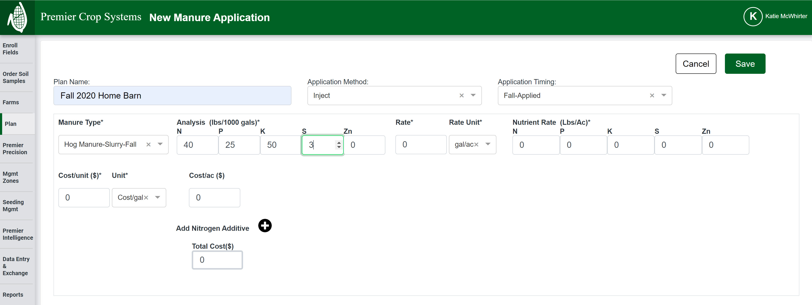

Slide 53


Slide 54
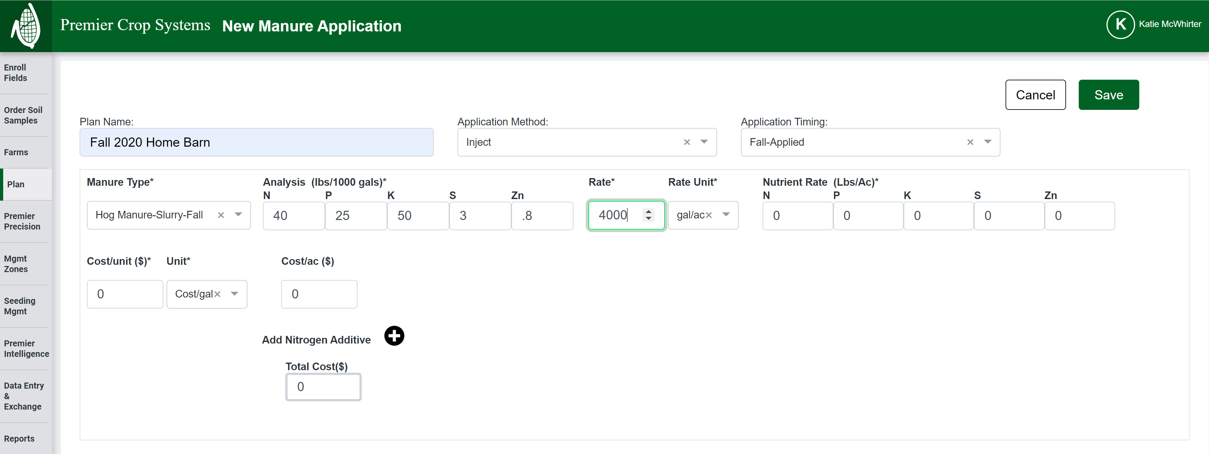

Slide 55
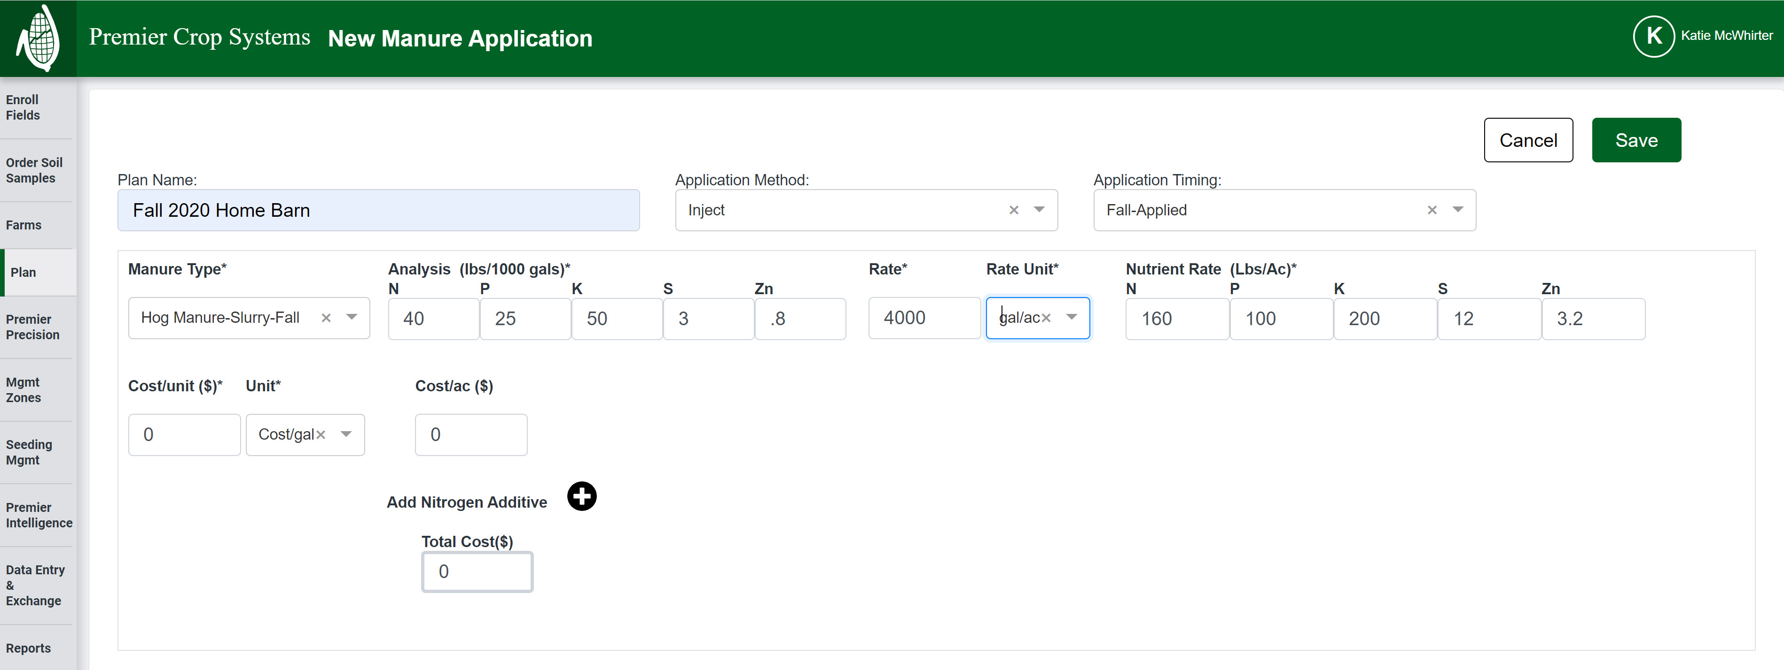

Slide 56
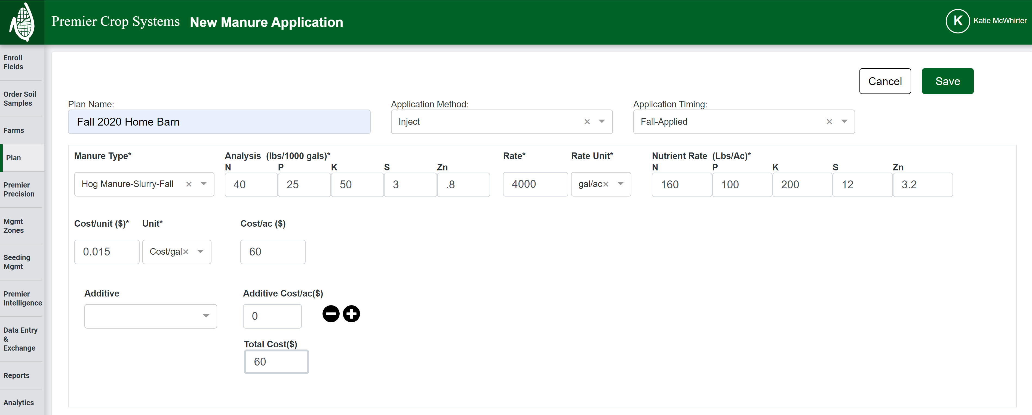

Slide 57
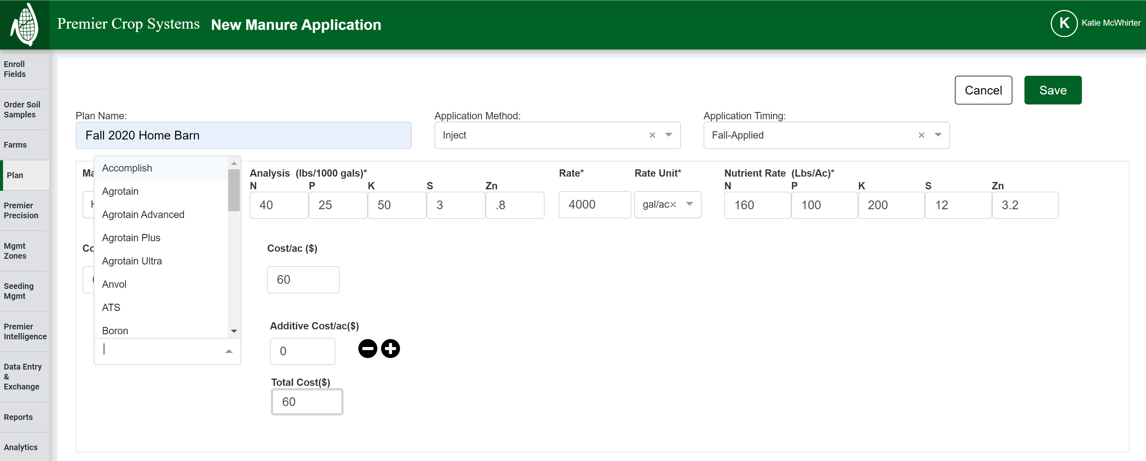

Slide 58
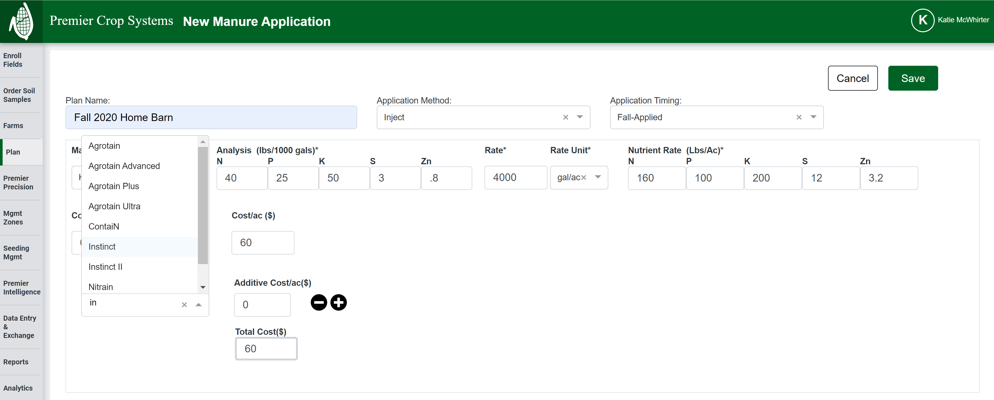

Slide 59
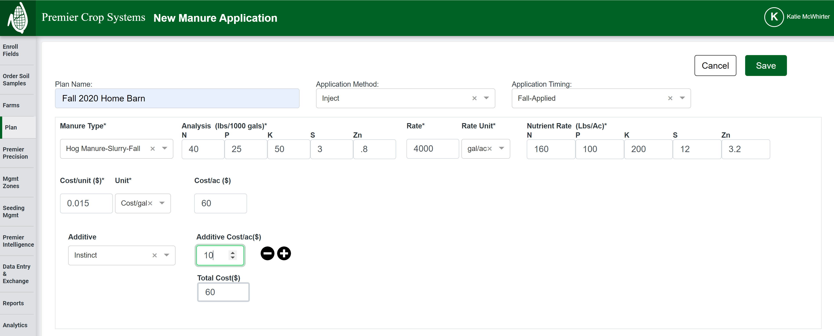

Slide 60


Slide 61


Slide 62


Slide 63


Slide 64


Slide 65


Slide 66


Slide 67


Slide 68


Slide 69


Slide 70


Slide 71


Slide 72


Slide 73


Slide 74
Disclaimer:
These will not be on the Grower Nutrient Reports (Plan, Entities, or Stakeholders) until January!

Slide 75
Seed Planned Products

Slide 78


Slide 80


Slide 81


Slide 82


Slide 83


Slide 84


Slide 85


Slide 86


Slide 87


Slide 88


Slide 89


Slide 90


Slide 91


Slide 92


Slide 93


Slide 94


Slide 95


Slide 96


Slide 97


Slide 98
Changes to Mgmt Zone

Slide 99


Slide 100


Slide 101


Slide 102


Slide 103


Slide 104


Slide 105


Slide 106


Slide 107


Slide 108


Slide 109


Slide 110


Slide 111


Slide 112


Slide 113


Slide 115


Slide 116


Slide 117


Slide 118


Slide 119


Slide 120


Slide 121


Slide 122


Slide 123


Slide 124


Slide 125


Slide 126


Slide 127


Slide 128


Slide 129


Slide 130


Slide 131


Slide 132


Slide 133


Slide 135


Slide 136


Slide 137


Slide 138


Slide 139


Slide 140


Slide 141


Slide 142


Slide 143
Disclaimer:
These reports will not be available until January/February!

Slide 144
What’s Next?
Moving a Plan to Actual
In Season Adjustments

Slide 145
QUESTIONS?
Thank you for all that you do!
Merry Christmas!
kmcwhirter@premiercrop.com

